Slide 1
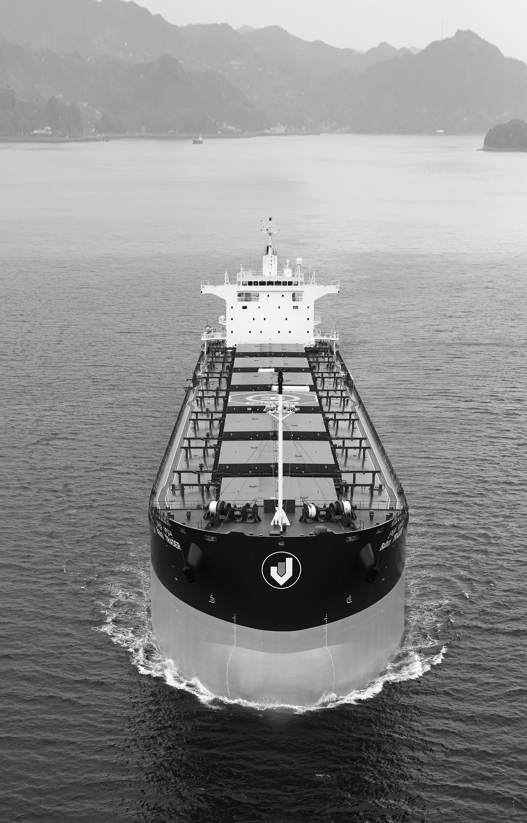


Welcome!
SMS Introduction for Seafarers
Updated May 2018

Slide 2
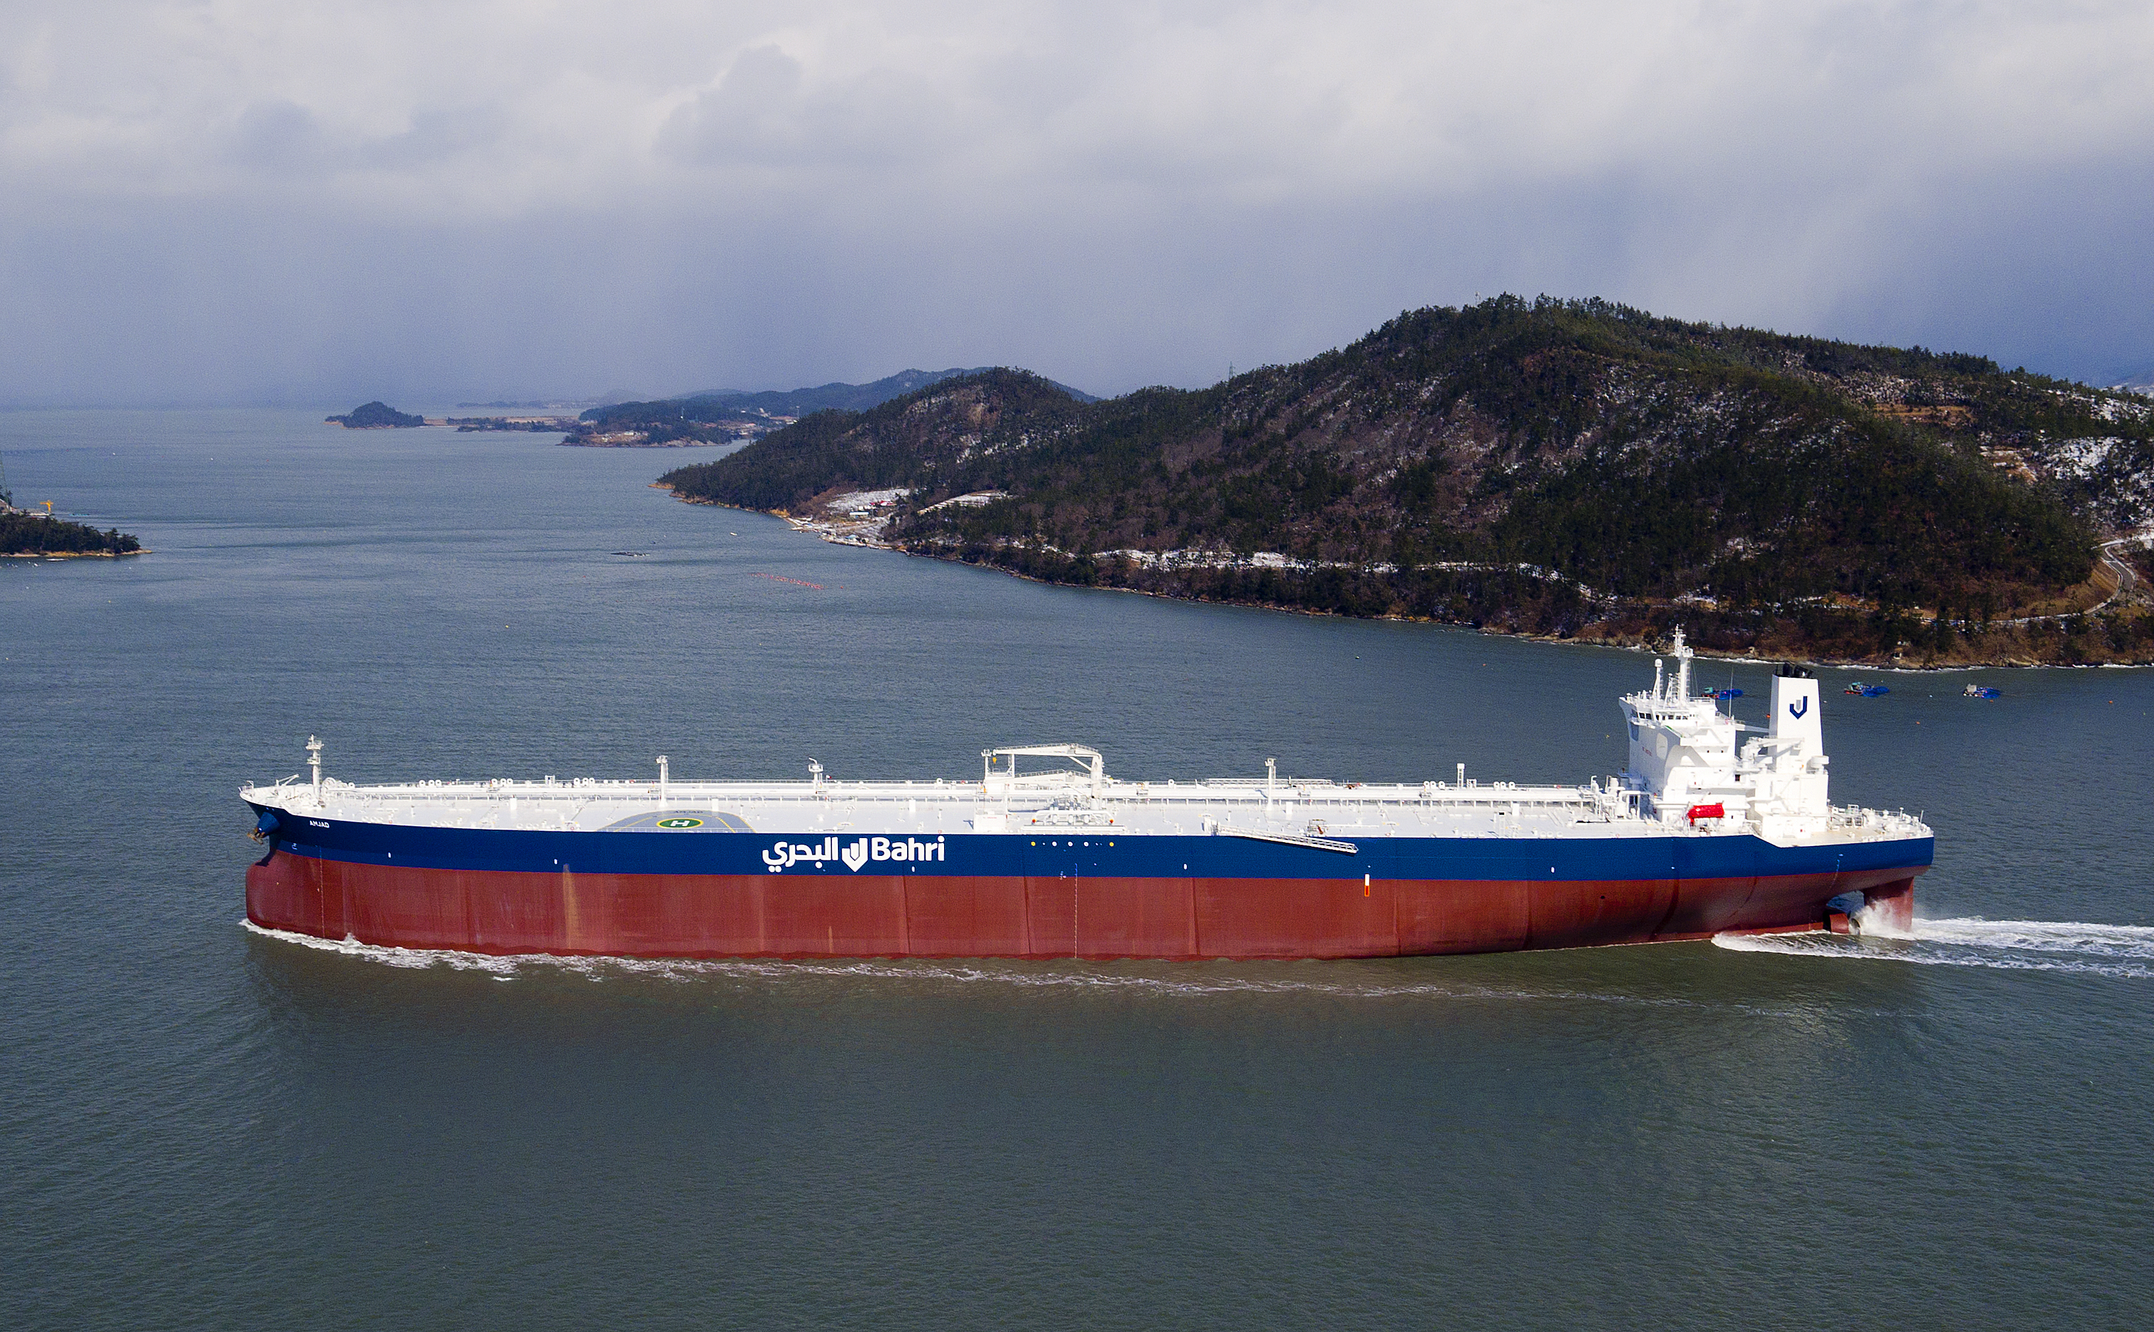
SMS Introduction for Seafarers
Modules
Who we are – What we do
Introduction to the SMS
Safety Basics
Environmental Excellence & Compliance
Welfare & Development
Company Incentives

Slide 3

Bahri Ship Management
“A focus that flows through Bahri Ship Management is the commitment to ensure that all its vessels are operated safely with a minimum risk to the environment, people and marine life; with consistently delivered world class service to our affiliations.”

Slide 4
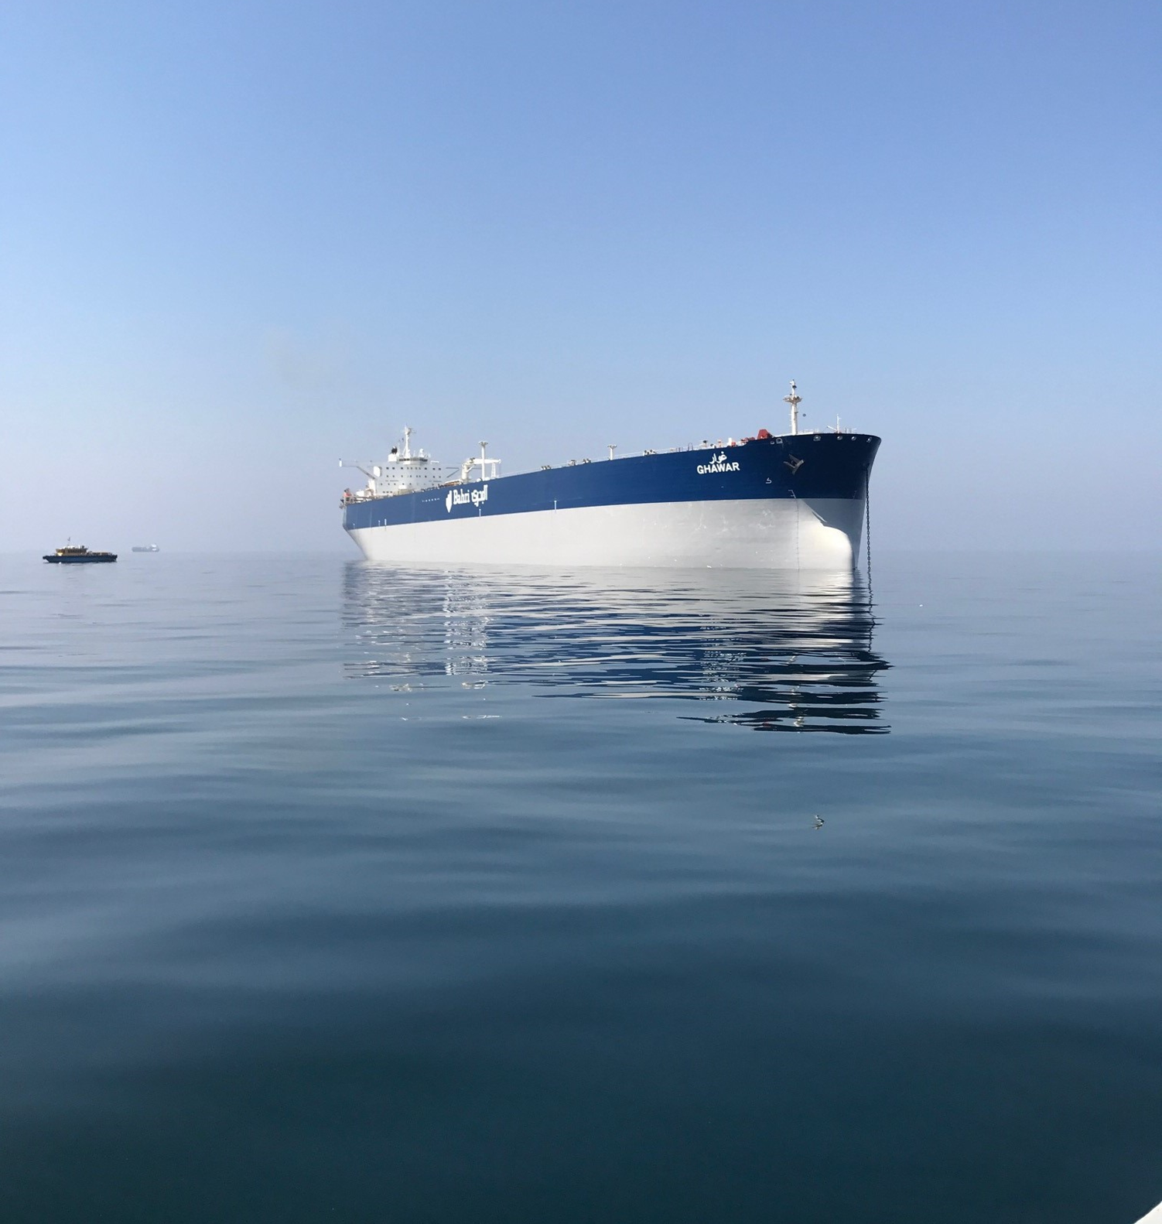





Who we are
A brief history of Bahri
1983 - Started operations as a national carrier in General Cargo
1990 - Diversified into the Chemical Transportation via a JV with SABIC
2011 & 2012 – Ordered 6 RoCon and 5 Dry Bulk vessels
2012 - Bahri Oil/Vela merger Bahri became the exclusive VLCC carrier for Saudi Aramco
2018 – Completed delivery of 10 New Build VLCCs
1996 – Bahri ventured in to VLCC operations
Notes:
A wholly owned subsidiary of the Bahri Group, Bahri Ship Management (formerly known as Mideast Ship Management Ltd.) provides comprehensive quality
ship management services to all of Bahri’s strategic sectors.
The Company’s office is located in the Dubai
With more than 4,000 world-class seafarers, that are supported by a dedicated shore based team of over 100 experienced and committed technical and marine superintendents, safety and quality specialists along with the support staff, it is ensured that the company provides the best possible and seamless quality of service to its customers.

Slide 5

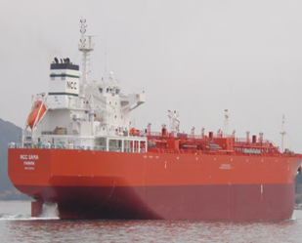
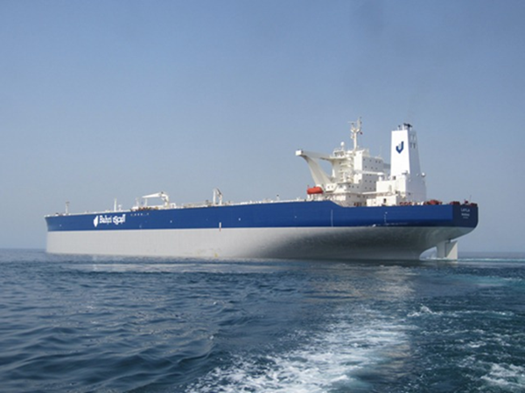
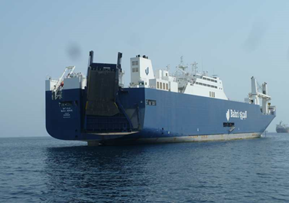
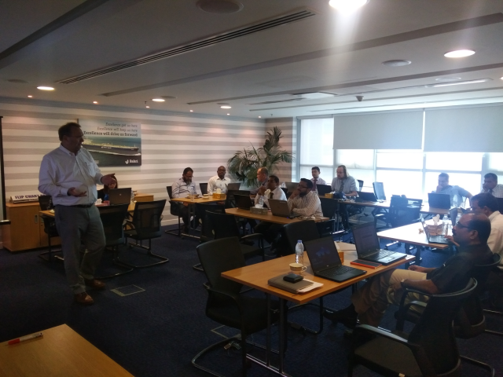
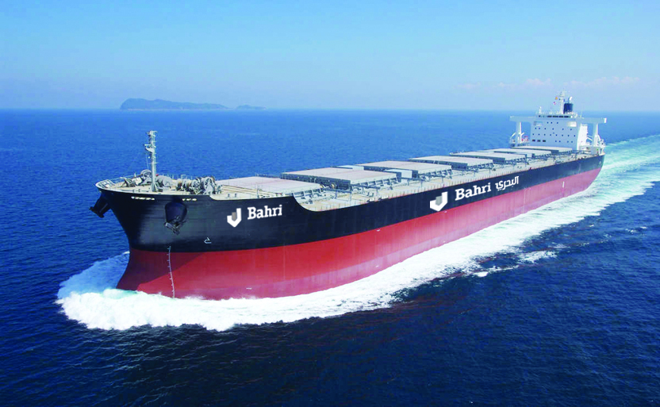
Who we are
Organized in Five Strategic Business Units (SBUs)
Notes:
5 Business units
Oil
Dry Bulk
General Cargo
Chemical
Ship Management

Slide 6
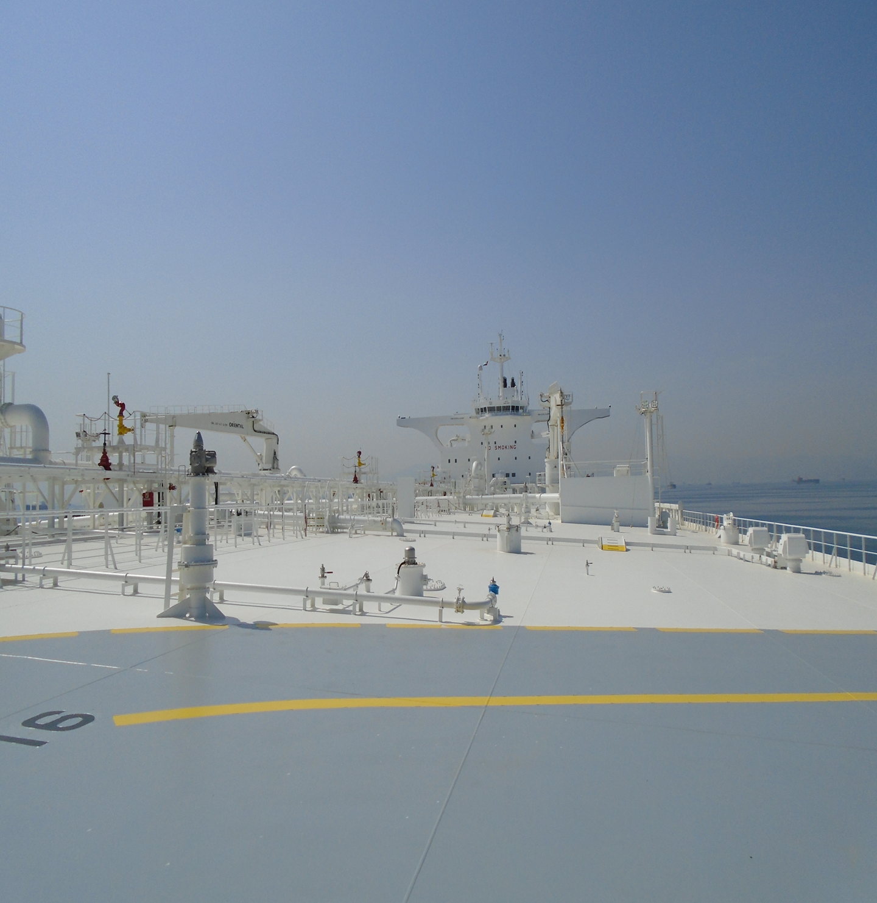
Who we are
Our fleet in numbers
Chemical
&
Product
Tankers
VLCCs
RoCon
Vessels
Dry Bulk
Vessels
Notes:
With 46 VLCCs on the water today we are the largest VLCC operator in the world.
One of the largest Chemical Tanker operators through our JV with Sabic. All of these vessels are 50k DWT or over and carry multiple parcels. 10 Product tankers of 50k DWT. Young fleet of 6 RORO & 5 Bulk Vessels built in 2013-14.

Slide 7
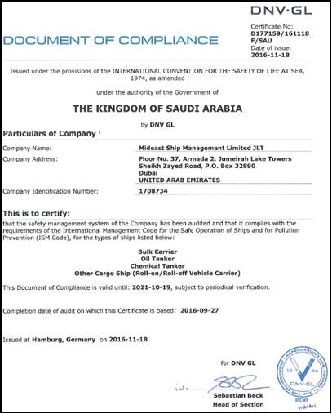
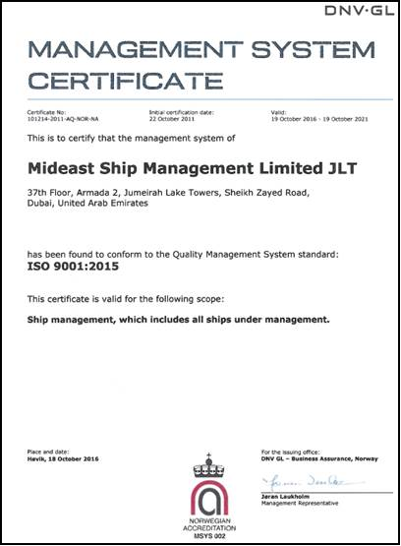
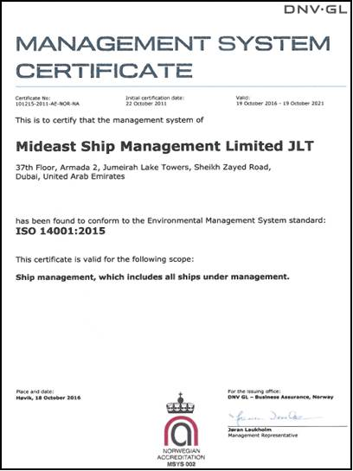
Who we are
Managed to the Highest Quality Standards
Notes:
Bahri Ship Management systems certified to ISO 9001, 14001 and in the near future 50001 standards, in addition to the mandatory ISM, ISPS and MLC.

Slide 8
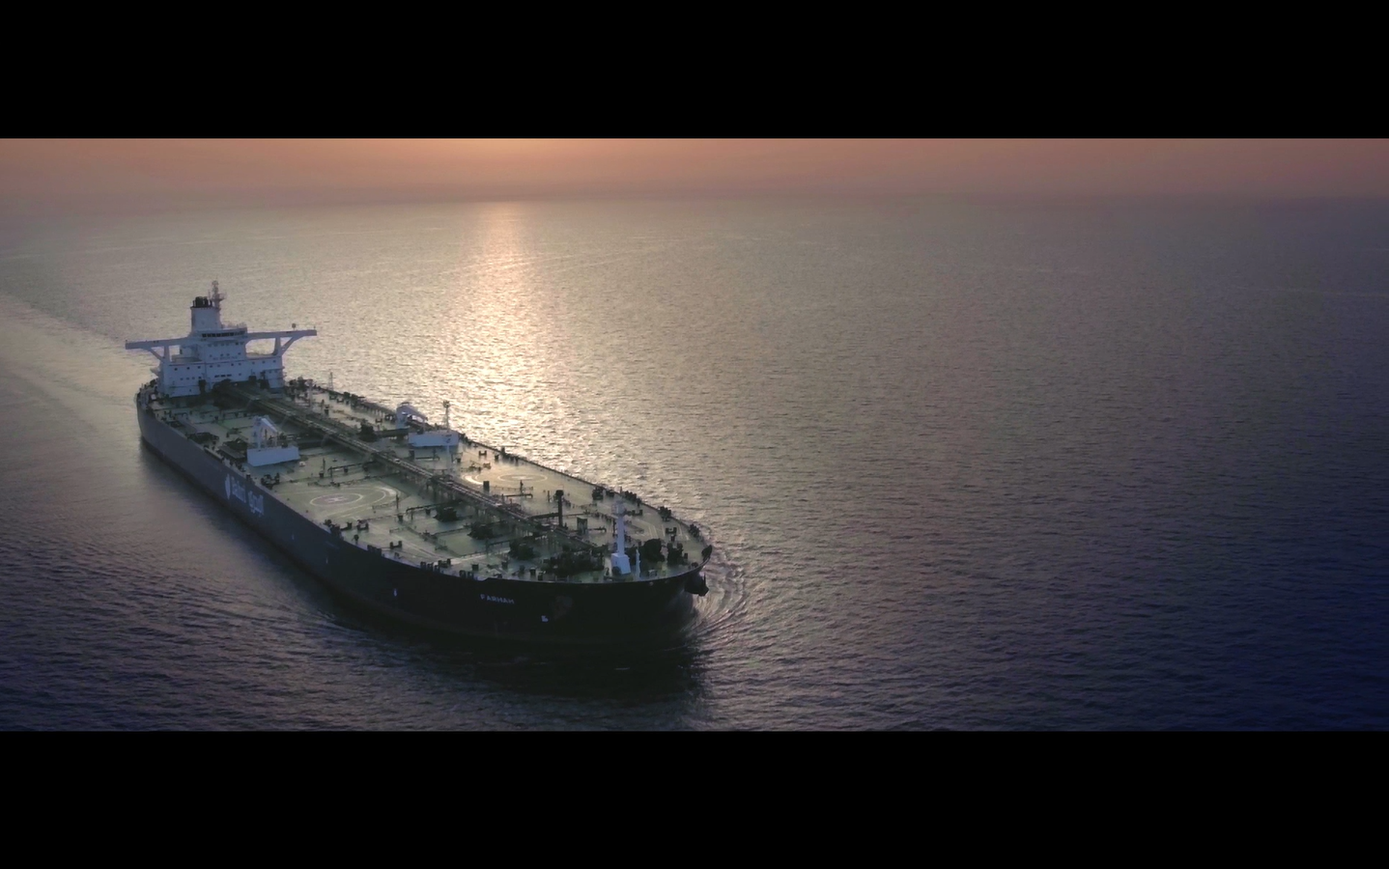

Who we are – What we do
Notes:
Play film provided

Slide 9

Section Title.
Introduction to the Safety Management System

Slide 10
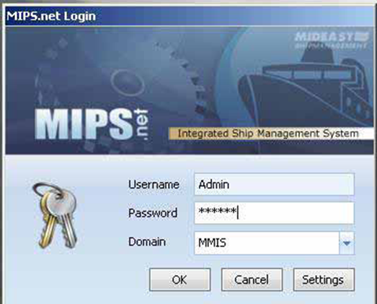
Introduction to the SMS
Mideast Information & Planning System (MIPS)
Used for:
Document Control / Electronic SMS;
Planned Maintenance System;
Record of Inspections;
Vessel Position / Noon Reports;
Ship/ Shore reporting;
Purchasing;
Crewing Module.

Slide 11
Introduction to the SMS
Top Level Policy Statements
Quality
Recruitment
Drugs & Alcohol
Energy Conservation
Security
HSE
Corporate Social Responsibility
Just Culture
Notes:
To achieve its vision of “Safety driven ship managers”, we have designed and are committed to comply with our six policy statements as follows:
Quality
Health Safety and Environment
Recruitment
Drug and Alcohol
Energy Conservation
Security
Just Culture
These policy statements can be found and read in MIPS/03 Policy statements folder and displayed outside Masters office in Common area. Also a copy available in Mideast management system booklet handed over to each crew.

Slide 12

Introduction to the SMS
SMS Structure
To meet the requirements of ISM code and those laid out in the ISO standards; we have the following ship board procedures:-
CNTGY – Contingency
CRW – Crewing
FGI – Fleet General Instructions
FMS – Forms
HSE-Health, Safety and Environment
NAV – Navigation
TEC – Technical
CL’s – Circular Letters
Additionally type specific manual as applicable are as follows:
TNK – OIL – Tanker Oil
TNK- CHEM – Tanker Chemical
ROCON – Ro-Ro Container
BLK – Bulk Carrier
Common to both ship and shore:-
QHSE Management Programme
Mideast Management System (MMS).
Notes:
QHSE Management Programme: This is Mideast’s documented procedure adopted for identifying aspects and impacts of ship operation on the environment.
It further provides guideline on how we determine significance of the aspects & impacts.
The Manual also presents the company’s KPIs (Key Performance Indicator) for the shore office and the ships.
Mideast Management System (MMS). This Manual is a core document which serves to provide the reader an insight into how Mideast has integrated the ISM Code, ISO 9001 and ISO 14001. It includes a tabulated cross reference to demonstrate how the various sections of the ISM and ISO standards are interlinked. In doing so, it provides a useful tool for an auditor, especially an external auditor, to determine if the company’s SMS meets all the requirements /clauses of the ISM Code, ISO 9001 and ISO 14001

Slide 13
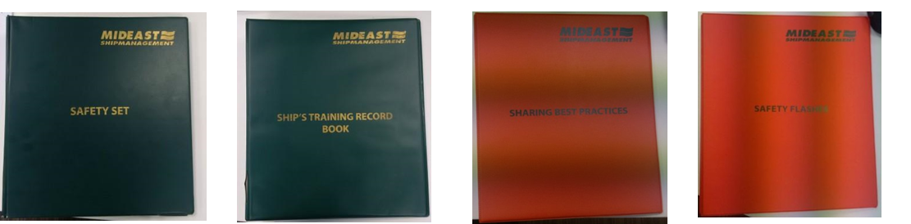
Introduction to the SMS
SMS Structure
The five additional documents listed below are also available in MIPS.
a) Safety Set
b) STRB (Ship Training Record Book)
c) SBP (Sharing of Best Practices)
d) Safety Flash, and
e) RA Folder.
NOTE - Items a & b shall remain in Chief Officer’s custody and items c to d shall be available to any crew member for reference purposes.
Additionally hard copies of Mideast/NAV and Mideast/CNTGY shall be maintained in the wheel house. Document Control responsibility for these shall be the Master’s; every time a new revision is issued Masters shall replace the contents in the green folder.

Slide 14
Introduction to the SMS
Support
First Point of Contact – The FPC is the appointed Marine Superintendent. He is to be contacted for all operational issues, accidents and incidents with the exception of emergencies for which Masters must call up the Hotline as stated below. For all technical issues the vessel may directly communicate with the appointed Superintendent Engineer, who in turn will keep the FPC advised accordingly.
Duty Person – for Emergency Contact. The company has provided a hot line (+ 971 56 6832440) for Masters to contact the shore office in an emergency situation and this number is linked to a roster system which assigns a duty person on rotation basis.
Designated Person Ashore (DPA) - shall be responsible for monitoring the safe and efficient operation of each ship with particular regard to the safety and pollution prevention aspects. In particular:-
to ensure compliance with the company safety management system
ensure that proper provision is made for each ship to be so manned, equipped and maintained that it is fit to operate in accordance with the safety management system and with statutory requirements.
Your DPA name and contact details are available on board and posted in common places for ready reference

Slide 15
Introduction to the SMS
MLC2006 – Complaints Procedure
Notes:
CRW/ Sec 6.14 Onboard complaint procedure
Any seafarer on board Mideast vessel wishing to present a complaint or labour grievance and have the issue investigated may follow the procedure stated in this section. Such complaints must be specific in nature and should constitute a breach of seafarer’s rights laid out under MLC 2006. Crew members have the right to file their complaints directly with the Master, or a Mideast representative or an external authority. External authority is a party other than Mideast’s representative, Master or company representative on board the vessel. This may include Port State Control official, local seafarer labour organization, or other seafarer welfare assistance service. This provision has been made to allow a seafarer who fears victimization to
exercise his right guaranteed under MLC 2006.
Each seafarer at time of joining shall be provided with a copy of this complaint procedure.

Slide 16

Section Title.
Safety - Basics

Slide 17
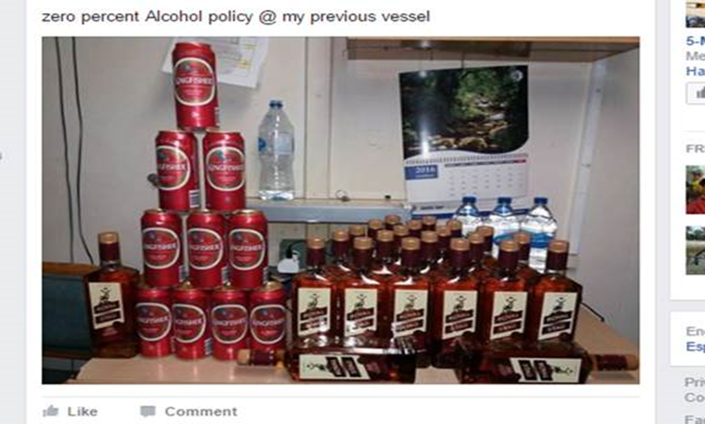
Safety Basics
Drugs & Alcohol
The carriage and consumption of alcohol and use or possession of non prescribed drugs is totally prohibited on board any of our vessels.
Possession of prescribed drugs for personal use is permitted provided it has been declared to the Master.
Offenders shall be dealt with severely.
Notes:
Crew Manual/Section-6.12/Drug and Alcohol testing requirements
The company will require all employees to submit to alchohol and/or drug testing at the time of pre-employment, which shall be valid for the entire tour of duty.
Unannounced drug and alcohol tests shall be carried out by a shore-based accredited medical Agency at least once a year, or as initiated from Management office.
A positive test result or refusal to submit to a drug and alcohol test is grounds for disciplinary action which may result in instant termination of employment.
Crew Manual/6.11.6 Random Breath Testing
Master shall carryout unannounced breath test of fifty percent of randomly selected ship-staff each month, and these fifty percent should include at least 4 randomly selected crew members from the list of those tested in the previous month.
The random selection process for tests should be such that each crew member is subjected to a breath test at least once every 4 months, and also ensuring each individual undergoes a breath test at least once during his contract period.
The Master shall use his discretionary powers to carry out additional breath tests, if there are reasons to believe that there has been alcohol abuse.
Random breath test on the Master shall be initiated by the office at least once during his contract. On receiving a telephone call from Mideast/QHSE the Master shall advise the Chief Officer to conduct the test in the presence of the Chief Engineer.

Slide 18


Safety Basics
Smoking
Smoking is totally prohibited outside the accommodation spaces at all times.
Smoking is totally prohibited in alleyways, corridors and food preparation areas.
Smoking on the Bridge is only allowed at the discretion of the Master.
Smoking is totally prohibited within all machinery spaces and adjacent storerooms.
Smoking will only be allowed within the Engine Control Room with the permission of the Chief Engineer.
Smoking in bed is strictly forbidden.
Smoking is prohibited in any area of the ship where paint, oils, rags or cordage are stowed and inside the ship’s stores.
Notes:
HSE / Section 6.5 / Smoking Regulations
Only safety matches are allowed on board the company’s ships and these are to be readily available.
The use of cigarette lighters is totally banned on board and Ship staff shall not bring on board any cigarette lighters. The Master along with Chief Engineer and Chief Officer shall check this during the weekly accommodation round and violators to this rule shall be given a formal warning. Repeated violation shall be subject to strict disciplinary action
Visitors (e.g.: Pilots, Surveyors, Inspectors etc) shall be advised not to use cigarette lighters onboard and they shall be provided with safety matches.
Safety matches must not be carried outside the accommodation and periodic checks are to be made of all crew members to ensure this instruction is complied with.
Use and possession of the traditional “shisha” or Hubbly-Bubbly pipes on board is strictly prohibited. The use of the tobacco type material “Maasal” is also prohibited.
The restriction on the use of 'E-cigarettes' is the same as for normal cigarettes.

Slide 19
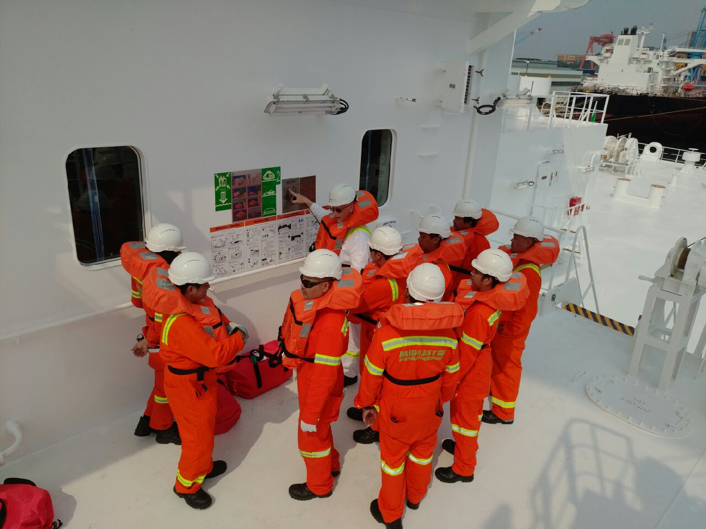
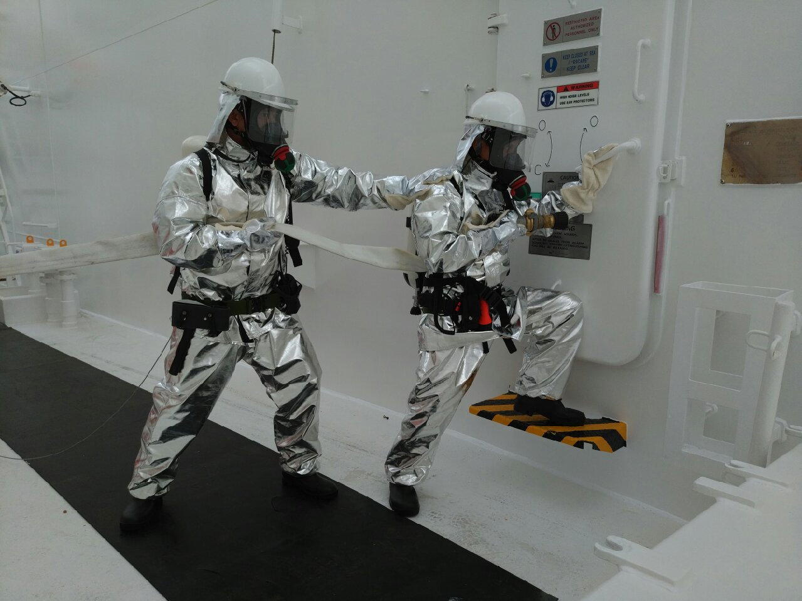
Safety Basics
Onboard Safety Familiarisation
All ship staff shall be familiar with the company’s Emergency organisation system and must also receive instruction in the following:
Procedure to raise the alarm.
Correct action upon discovering a fire or a casualty in an enclosed space.
Preparation and lowering of lifeboats and life-rafts.
Closing-down procedures for all spaces including reporting the fact that this has been affected.
Correct use of fire fighting appliances and
Correct use of life saving appliances.
There are additional familiarization procedures for the Navigation Officers.
Notes:
HSE / Section 2 / Safety Induction & Training Procedure
All newly joined personnel must undertake a Ship familiarisation briefing and be trained in the use of various ships’ equipment as per the details laid down in the Ships Training Record Book. They should
also study the fire fighting and lifesaving plan, SOLAS Training manual, Fire Training manual and SOPEP or SMPEP.
All ship staff shall be familiar with the company’s Emergency organisation system and must also receive instruction in the following:
◻ Procedure to raise the alarm.
◻ Correct action upon discovering a fire or a casualty in an enclosed space.
◻ Preparation and lowering of lifeboats and life-rafts.
◻ Closing-down procedures for all spaces including reporting the fact that this has been affected.
◻ Correct use of fire fighting appliances and
◻ Correct use of life saving appliances.
All personnel must be familiar with the contents of the ship specific SOLAS Training Manual and Fire Training Manual which are provided as a statutory requirement.

Slide 20
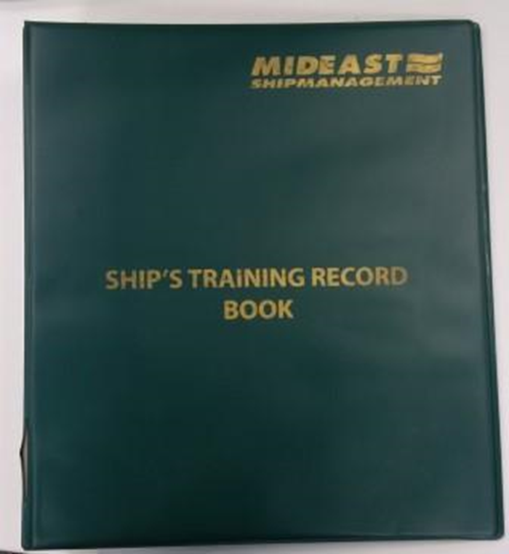
Safety Basics
Safety Training Record Book
Vessel is supplied with a Training Record Book, where records of on board familiarization and training are to be retained.
Master’s and other senior officers must familiarize themselves with the contents of the Training Record Book, especially the Schedule of Drills, and ensure all personnel receive the appropriate training for their rank.
1

Slide 21
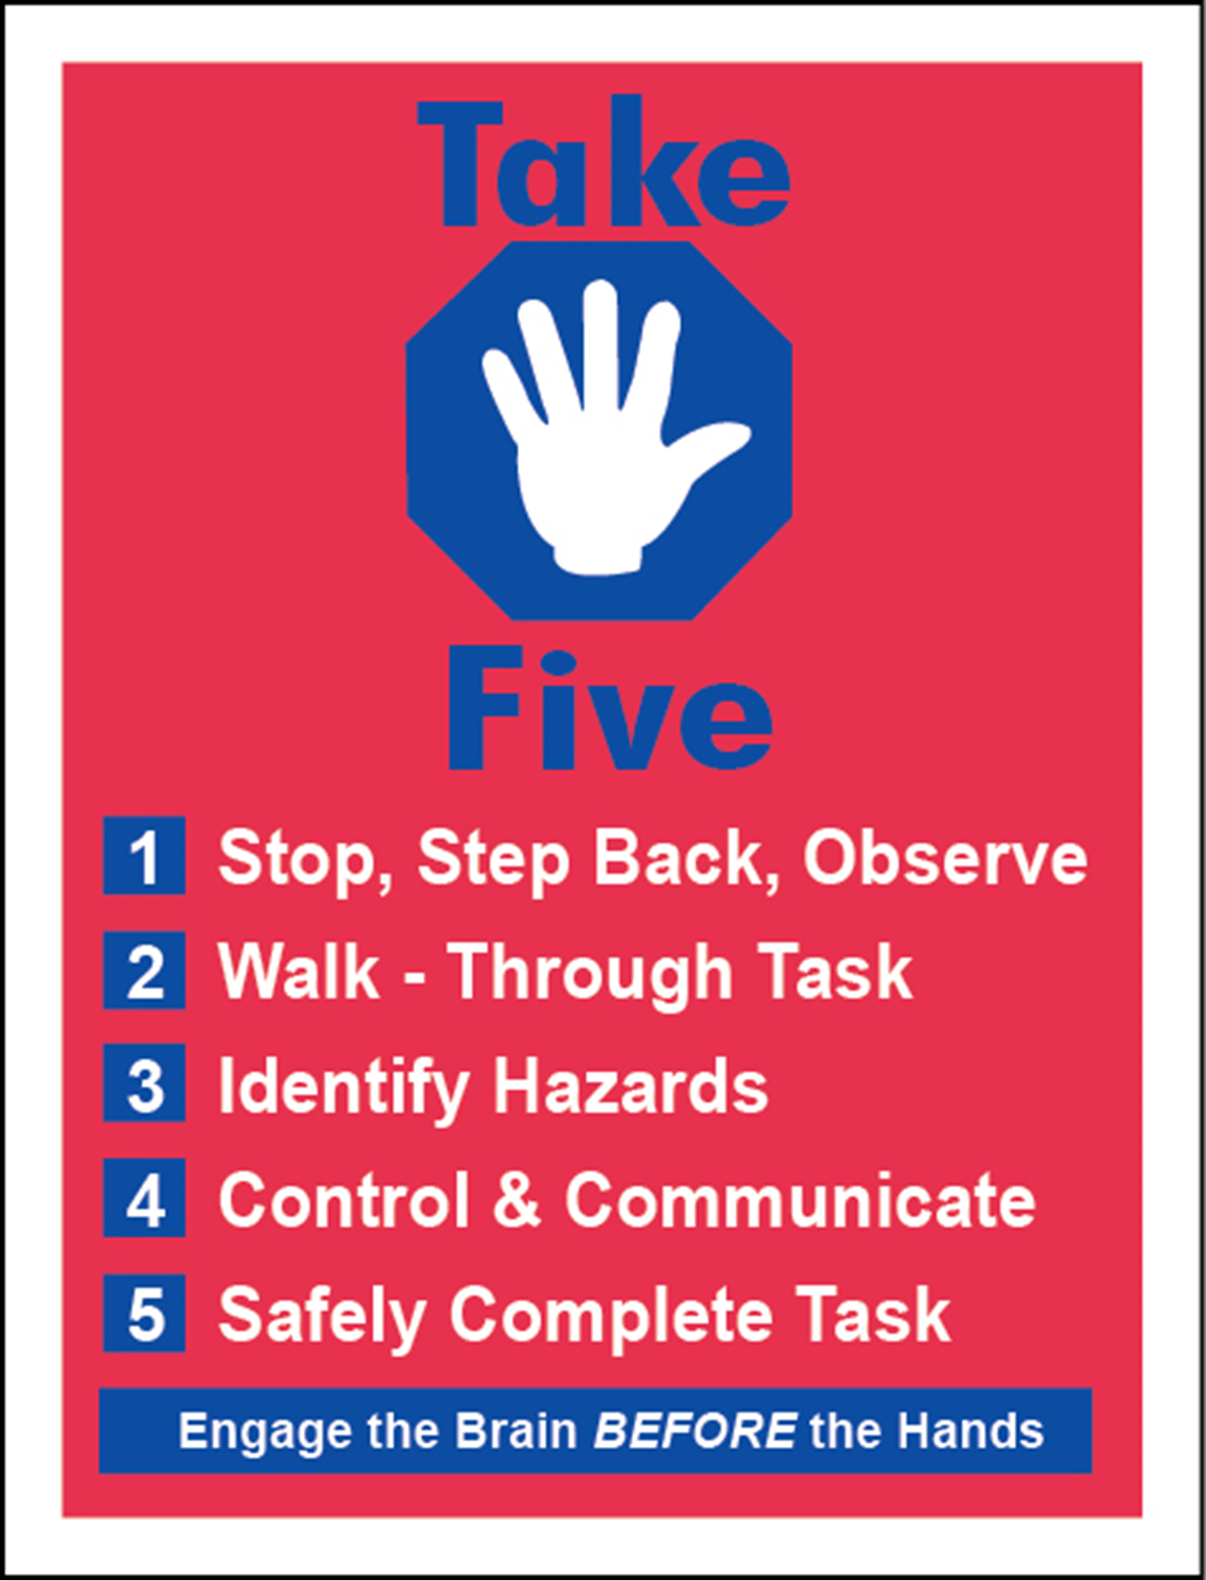
Safety Basics
Take-5
Notes:
HSE / Section 1.14
What is Take 5?
• Tool for safe implementation of tasks
• Informal personal risk assessment
Based on “Engaging the Brain BEFORE the hands” & 5 simple steps
1) Stop, Step Back & Observe
• Observe work area for potential hazards
2) Walk through the Task
• Analyze each task step
• Walk through each step mentally considering each one in turn
Identify the Hazards associated or generated by the task
Control & Communicate
• Remove hazards
• Communicate actions to relevant personnel
Safely Complete The task
Tips
Manual Handling
1) Can I slip, trip or fall?
2) Can I safely handle objects?
3) Am I in the best position for the task?
4) Consider the objects weight
Product / Chemical Exposure
1) Harmful product/ chemical? Checked MSDS or another source?
2) Risk of inhalation, ingestion or contact
3) Correct PPE
Product Escape / Contamination (Fittings, valves, Flanges or Hoses)
1) Possibility of product / vapor spill or leak
2) Product fits into the tank
3) Correct tank?
Energy Sources (Electricity, gas, steam and other heat sources, compressed air, mechanical, noise, etc)
1) Isolated energy source?
2) Considered stored energy?
3) Considered other unaccounted routes of energy
Wider Picture
1) Tidy and safe area
2) Clear escape route
3) Impact of task on me/ others

Slide 22
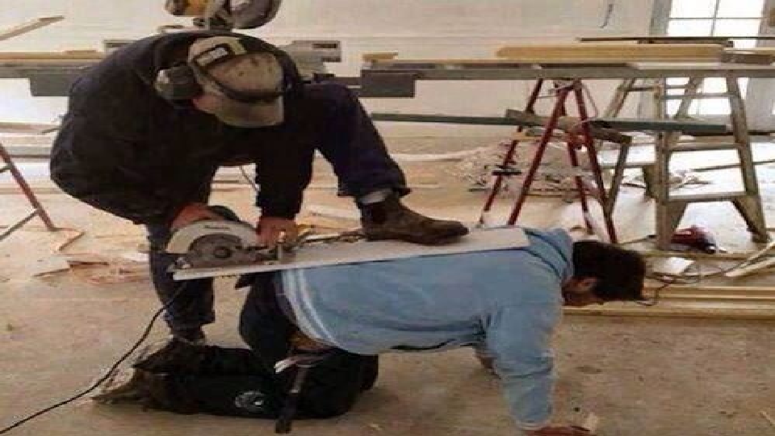
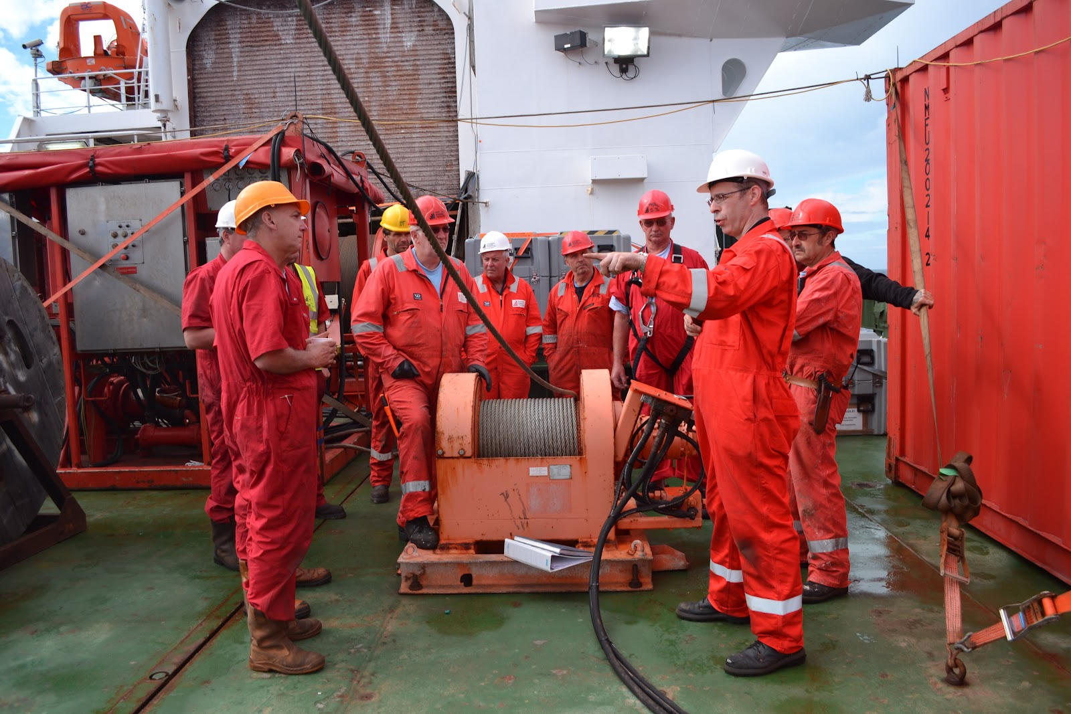
Safety Basics
Tool Box Talks
A toolbox talk is a method of determining that all safeguards are in place before work is carried out.
Toolbox talks can be used at any time to discuss safety in the workplace.
These discussions are an essential part of reducing risk.
The toolbox talk is to cover such areas as:
Steps, hazards and controls from the risk assessment
Roles and responsibilities of those involved in the activity
How the task will affect other people and systems
Work permits required
Emergency actions required in the event of an incident
Stopping work if work practices or work site is unsafe
Notes:
HSE Section1.6.2

Slide 23
Safety Basics
Reporting & Intervention – “Chronic Unease”
Bahri Safety Climate Survey:
37% believed that a serious incident COULD not occur on their ship
Why is this bad?
Leads to complacency, poor situational awareness, poor decision making.

Slide 24
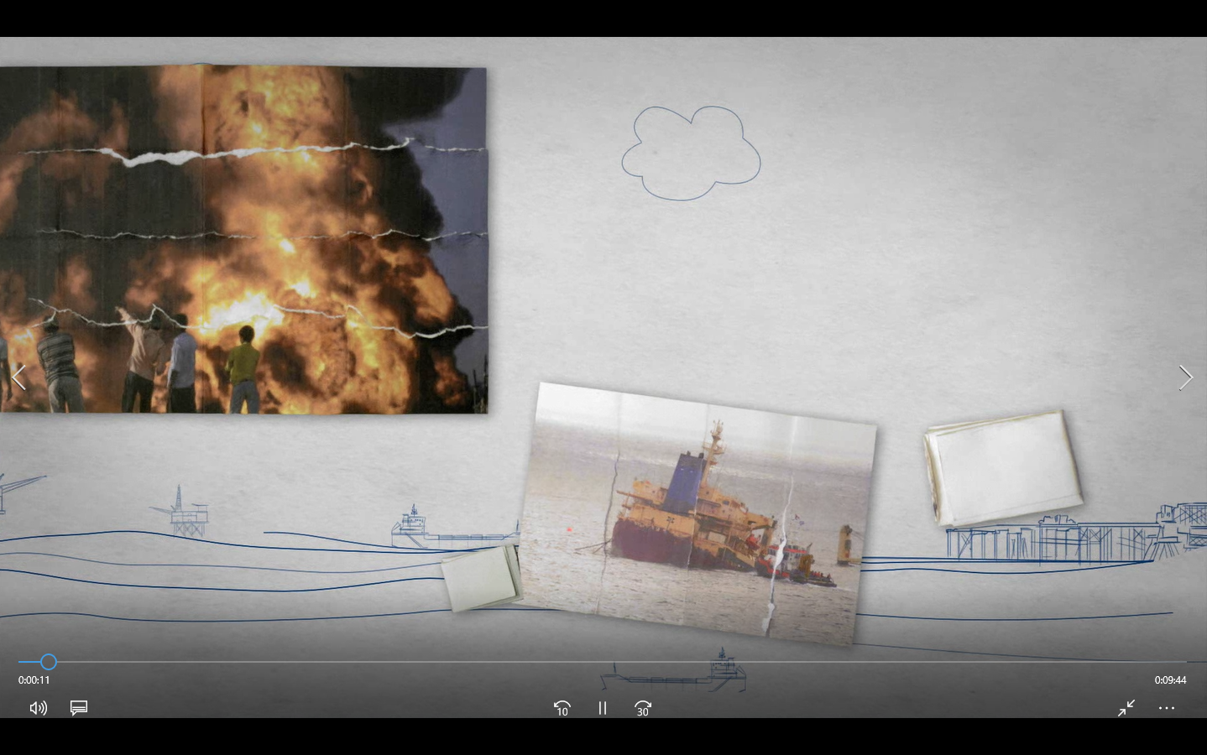

Safety Basics
Reporting & Intervention – “Chronic Unease”

Slide 25

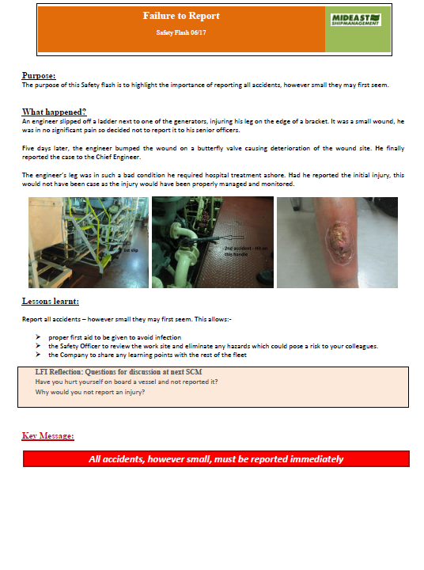
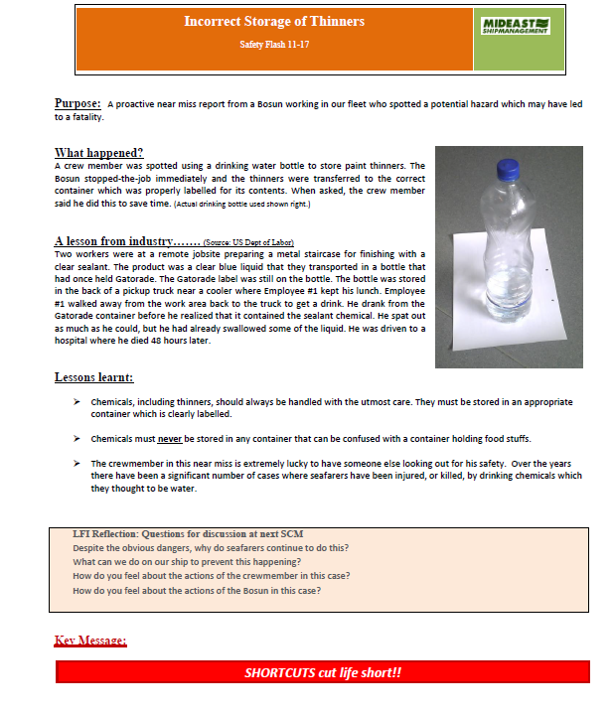
Safety Basics
Stop-The-Job Authority
Everybody makes mistakes. Not intentionally
Highly qualified and experienced persons also make mistakes.
Within the office, and on board our vessels, the atmosphere must be such that every person feels empowered to report unsafe situations without fear of repercussions.
Leaders must be receptive to such reports.
Notes:
For Details Refer to HSE / Section 1.7 / Stop Work Authority

Slide 26
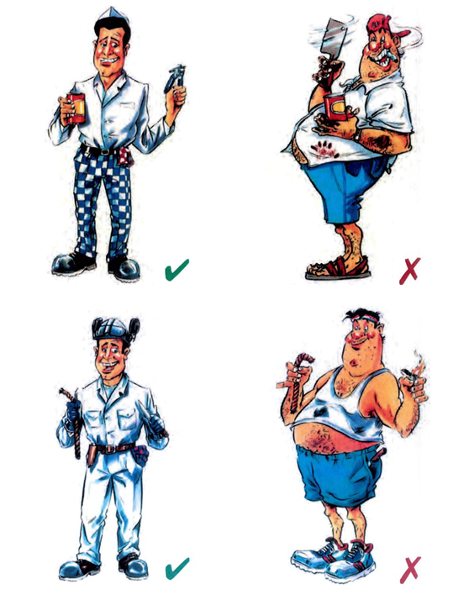

Safety Basics
PPE
Wear Boilersuits at all times
Wear Safety shoes outside accommodation
Wear Goggles and eye protection
Use the PPE Matrix
Safety helmets protect from impact damage
Ear defenders protect from noisy environments
Gloves help prevent injury

Slide 27
Notes:
For Details Refer to HSE Section 4.5 & Appendix 1 & 2

Slide 28

Safety Basics
Permit To Work System
PTW 01 – Aloft/Over-side
PTW 02 – Electrical isolation
PTW 03 – Pipelines and pressure vessels
PTW 04 – Hot work
PTW 05 – Pressure testing of pipelines and hoses
PTW 06 – Enclosed space entry
PTW 07 – Portable Cutting Tools and hydro-blaster
PTW 08 – Pump room entry
PTW 09 – Diving operations
PTW 10 – Cargo tank entry for chemical tankers
PTW 11 – Maintenance of passenger lift
PTW 12 - Scaffolding work
Notes:
HSE/ Section 11.0-PERMIT TO WORK SYSTEM
The company has identified certain key shipboard operations which must be controlled through a ‘Permit to Work’ system. In developing the work permits for select jobs consideration has been given to all the risks/hazards associated with the task and ensure that appropriate controls are in place prior commencement of the work.
Tasks for which a ‘Work Permit’ is available do not need a formal risk assessment with the exception of ‘Hot Work Permit’ where a formal risk assessment is mandatory.

Slide 29
Safety Basics
Isolation Control
Risk Assessment and Permits to work are essential
Enforce isolation control of energy systems before work –
electrical,
mechanical,
hydraulic,
pneumatic, steam,
chemical,
Gas, and
all other forms of energy.
Proceed with Extreme Caution
Familiarize personnel with test procedures
Notes:
Refer to Section 8 / Safety signs & Tags (Subsection HSE 8.4 Safety Tags)
To ensure that all ship crew and contractors are protected from accidental or unexpected activation of electrical, mechanical, hydraulic, pneumatic, thermal (steam), chemical, gas and all other forms of energy.
Minimum requirements based on isolation, warning and de-energisation of all energy sources, which could cause injury or death.
Isolation is the practice of using devices or seals on or around a component of a system, visually indicating and preventing personnel from operating the component that is isolated. The purpose of the isolation device or seal is to avoid the operation or altering of the current position of the component (i.e.
valves, switch gear, or energy isolating device etc) which may lead to an accident, by the start-up or release of stored energy in the system.
Tag-out is defined as the practice of using warning tags to increase the visibility, awareness and caution that the machinery/equipment is not to be energized or activated.
Senior Officer assigned to the task shall be responsible for correct implementation of this procedure, whereas ship’s crew and contractors are responsible for compliance, with all new joiners and contractors being instructed as to the purpose and use of the Isolation/tag-out procedure.

Slide 30
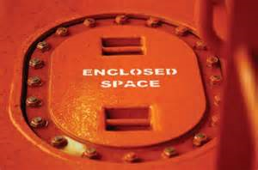
Safety Basics
Enclosed Spaces
Notes:
This list is not exhaustive and shipboard management team shall produce a ship specific list to identify enclosed spaces.
Entry into any enclosed spaces is inherently dangerous unless the precautions laid down in this chapter are strictly observed at all times. Entry doors or hatches leading to enclosed spaces
where entry is not planned or required should at all times be secured against entry.
The Master is to ensure that entry is not permitted into any enclosed space until a responsible Officer has:
◻ Ascertained that space is ventilated.
◻ Tested the atmosphere with the appropriate equipment.
◻ Ascertained that it is free from toxic vapours and not deficient in oxygen
◻ Enclosed space entry permit as applicable has been completed and approved. (Chemical tankers have a separate work permit for entry into cargo tanks).
A responsible officer must continuously supervise the operation and should ensure that:
• The personnel involved are well trained in the use of breathing apparatus and are aware of the dangers of removing their face masks while in the unsafe atmosphere.
• Personnel use positive pressure breathing apparatus and are connected to a lifeline.
• The number of persons entering the tank is kept to a minimum consistent with the work to be performed.
• Ventilation is provided where possible.
• Means of continuous communication are provided and a system of signals is agreed and understood by the personnel involved.
• Spare sets of breathing apparatus, a resuscitator and rescue equipment are available outside the space and a standby party, with breathing apparatus donned, is in attendance in case of an emergency.
• All essential work that is to be undertaken is carried out in a manner that will avoid creating an ignition hazard.
• Repetitive gas checks are being conducted as required by the permit.
Responsible officer can delegate all or some of above duties to trained personnel on board.
Note: Responsible Officer is a different person than the team leader entering the tank. In cases where Chief Officer or second engineer become the part of the entry team; Master or Chief engineer should assume the role of responsible officer.

Slide 31
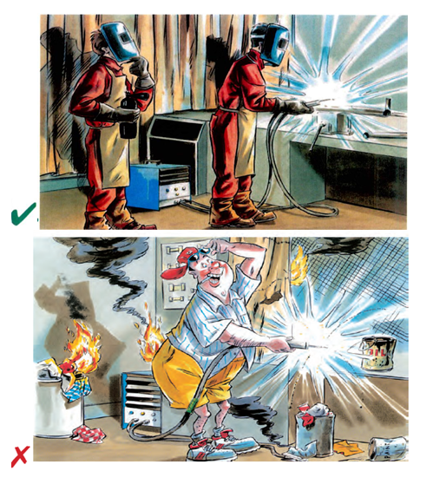
Safety Basics
Welding and Burning (Hot Work)
Welding/Hot work should be carefully planned
Personal protective equipment requirements should be identified
Potential hazards should be identified
Fire extinguishers should be at the site and methods of raising fire alarms should be clearly established
Welding machines should be direct current (DC) machines with maximum 70 V open circuit
Notes:
Hot work in places other than the workshop should be the subject of a permit to work
Operators should be suitably trained in the process, familiar with the equipment to be used and instructed where special precautions need to be taken.
Before welding, flame cutting or other hot work is started, a check should be made that there are no combustible solids, liquids or gases at, below or adjacent to the area of work that might be ignited by heat or sparks from the work.
When hot work is to be done in the vicinity of open hatches, suitable screens should be erected to prevent sparks dropping down hatchways or hold ventilators.
Port holes and other openings through which sparks may fall should be closed where practicable.
When work is being done close to or at bulkheads, decks or deckheads, the far side of the divisions should be checked for materials and substances that may ignite, and for cables, pipelines or other services that may be affected by the heat.
Cargo tanks, fuel tanks, cargo holds, pipelines, pumps and other spaces that have contained flammable substances should be certified as being free of flammable gases before any repair work is commenced. The testing should include, as appropriate, the testing of adjacent spaces, double bottoms and cofferdams. Further tests should be carried out at regular intervals and before hot work is recommenced following any suspension of the work. When carrying out hot work on tankers and similar ships, all tanks, cargo pumps and pipelines should be thoroughly cleaned and particular care taken with the draining and cleaning of pipelines that cannot be directly flushed using the ship’s pumps.
Where portable lights are needed to provide adequate illumination, they should be clamped or otherwise secured in position, not handheld, with leads kept clear of the working area.
Hot work should be properly supervised and kept under regular observation. Suitable fire extinguishers should be kept at hand ready for use during the operation. A person with a suitable extinguisher should also be stationed to keep watch on areas that may be affected that are not visible to the seafarer doing the work.
In view of the risk of delayed fires resulting from the use of burning or welding apparatus, frequent checks should be made for at least two hours after the work has stopped.
Extra precautions are required when doing hot work in an enclosed area

Slide 32
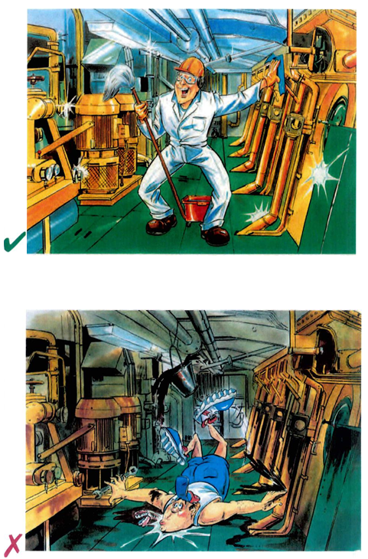
Safety Basics
Good House Keeping
VITAL part of shipboard safety management
Must DO:
  Clean Work place
  Clear Oil spills
  Remove Obstacles
  Fence off opening is decks
  Mark safe paths of access for crew/visitors
  Return tools after use
  Dispose garbage as per legislation
  Rectify oil leaks promptly
  Secure equipment/stores

Slide 33
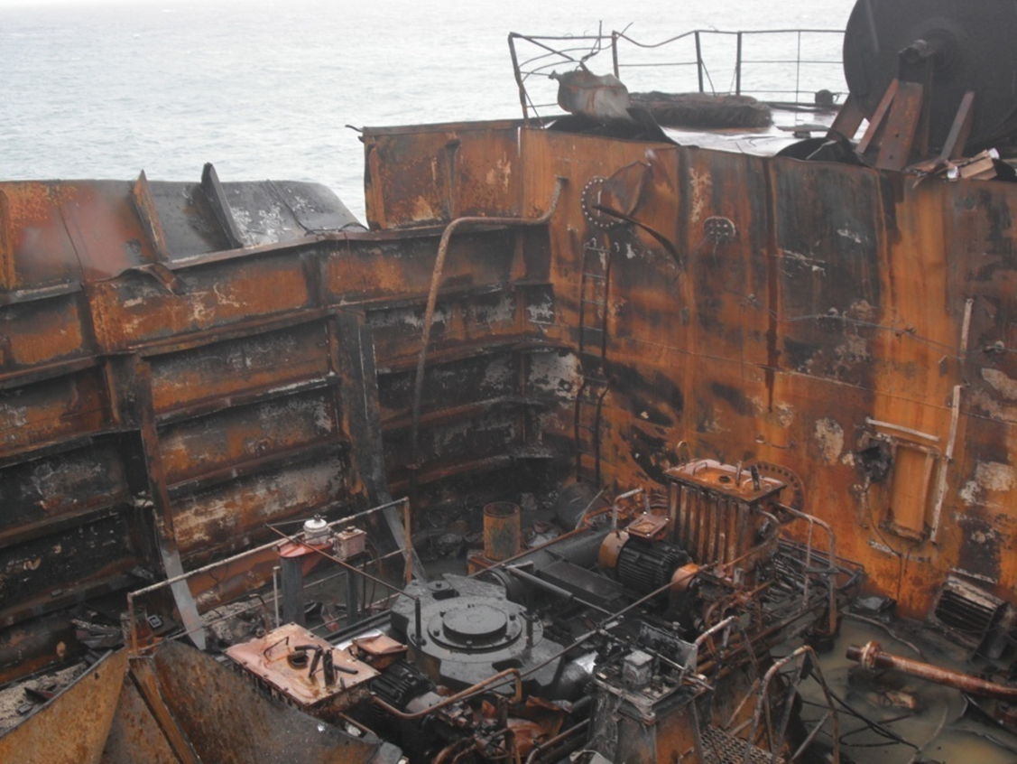
Safety Basics
Fire Safety
On average in our industry:-
150 Major incidents involving fire or explosion on Merchant vessels each year.
400 people killed by fire at sea
This means there is a serious fire at sea every two days and the average fire kills three of our fellow seafarers.
Notes:
Considering the wide range of both sources of fuel and sources of ignition within the engine room, it should come as little surprise that a large proportion of fires onboard ships originate there.
Research coordinated by IMO has indicated that between 30 and 50% of all fires on merchant ships originate in the engine room, most of which are caused by oil leaks from pressurized systems.
Special attention should be given towards maintaining a clean and tidy engine room where machinery and emergency control equipment are installed and operated in accordance with our SMS requirements and that theequipment is routinely serviced and maintained in good working order.
Good housekeeping is essential
Keep fire doors closed – never use hold-backs

Slide 34

Safety Basics
Using Machine and Hand Tools
Every JOB has a CORRECT TOOL
Usage of WRONG tool leads to POTENTIAL HAZARDs
HAND HELD power tools
  can be potentially dangerous
  should only be used in accordance with manufacturer’s instructions
  Should be operated by experienced and trained staff
Machine Tools
  Improper usage can lead to accidents and injuries
  Should be operated by trained and competent personnel
Tool Guards
  Should be fitted to all machine tools
  Should be of approved designs
  Should be fully compatible with the machine

Slide 35
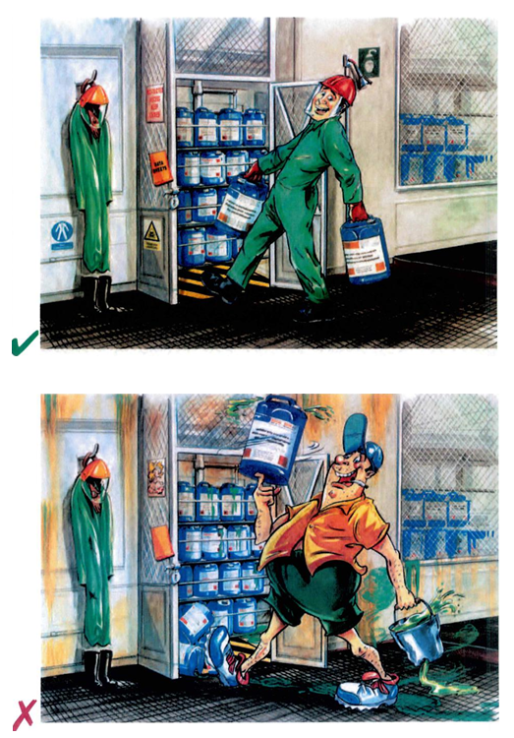
Safety Basics
Handling shipboard chemicals
Personnel involved should be familiar with potential hazards and emergency procedures
Shipboard chemicals should be stored in central store
Relevant safety notices should be placed inside and outside the chemical locker.
Access to chemicals should be restricted
Indiscriminate chemicals storage should be avoided

Slide 36
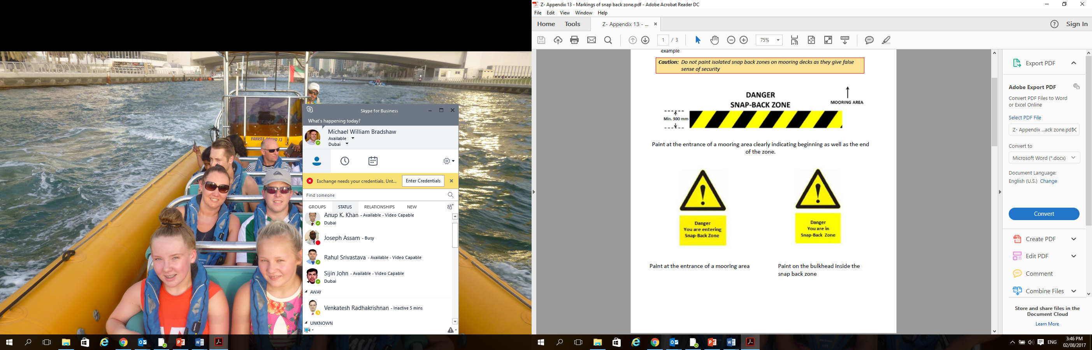
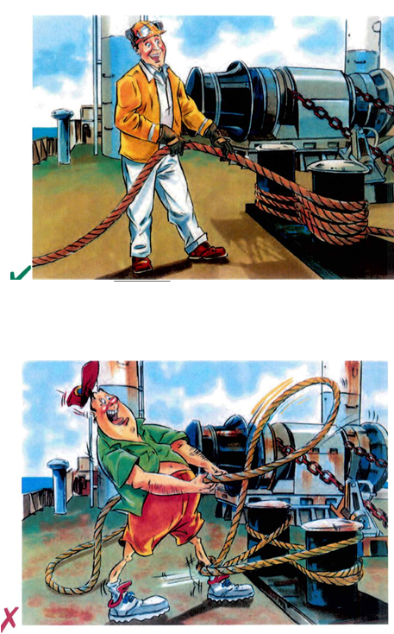
Safety Basics
Mooring and Anchoring Operations
Personnel involved should wear personal safety equipment
Working areas should be anti-slip
Anchors should be secured for sea with care
Ropes and wires should be regularly inspected
When alongside, moorings should be monitored
Correct personal protective equipment plays a vital role in the prevention of injury during mooring and anchoring operations
DON’T RISK LIFE OR LIMB – KEEP CLEAR OF SNAP-BACK ZONES!
Notes:
For Details Refer to HSE Section 15.5.7
All mooring lines under tension will stretch, particularly those made from synthetic material. Should the line break, stored energy will be released as it reverts to its original length. The two ends of the line will recoil or “snap-back” towards and past the points to which they are secured. Any person standing within the snap-back zone at either end of the line will risk serious injury or death.

Slide 37
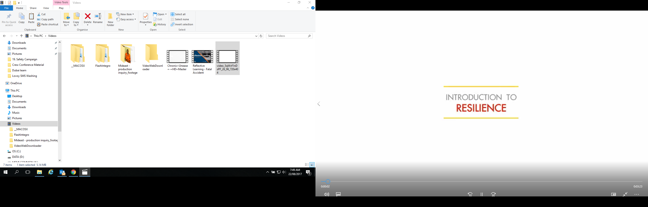
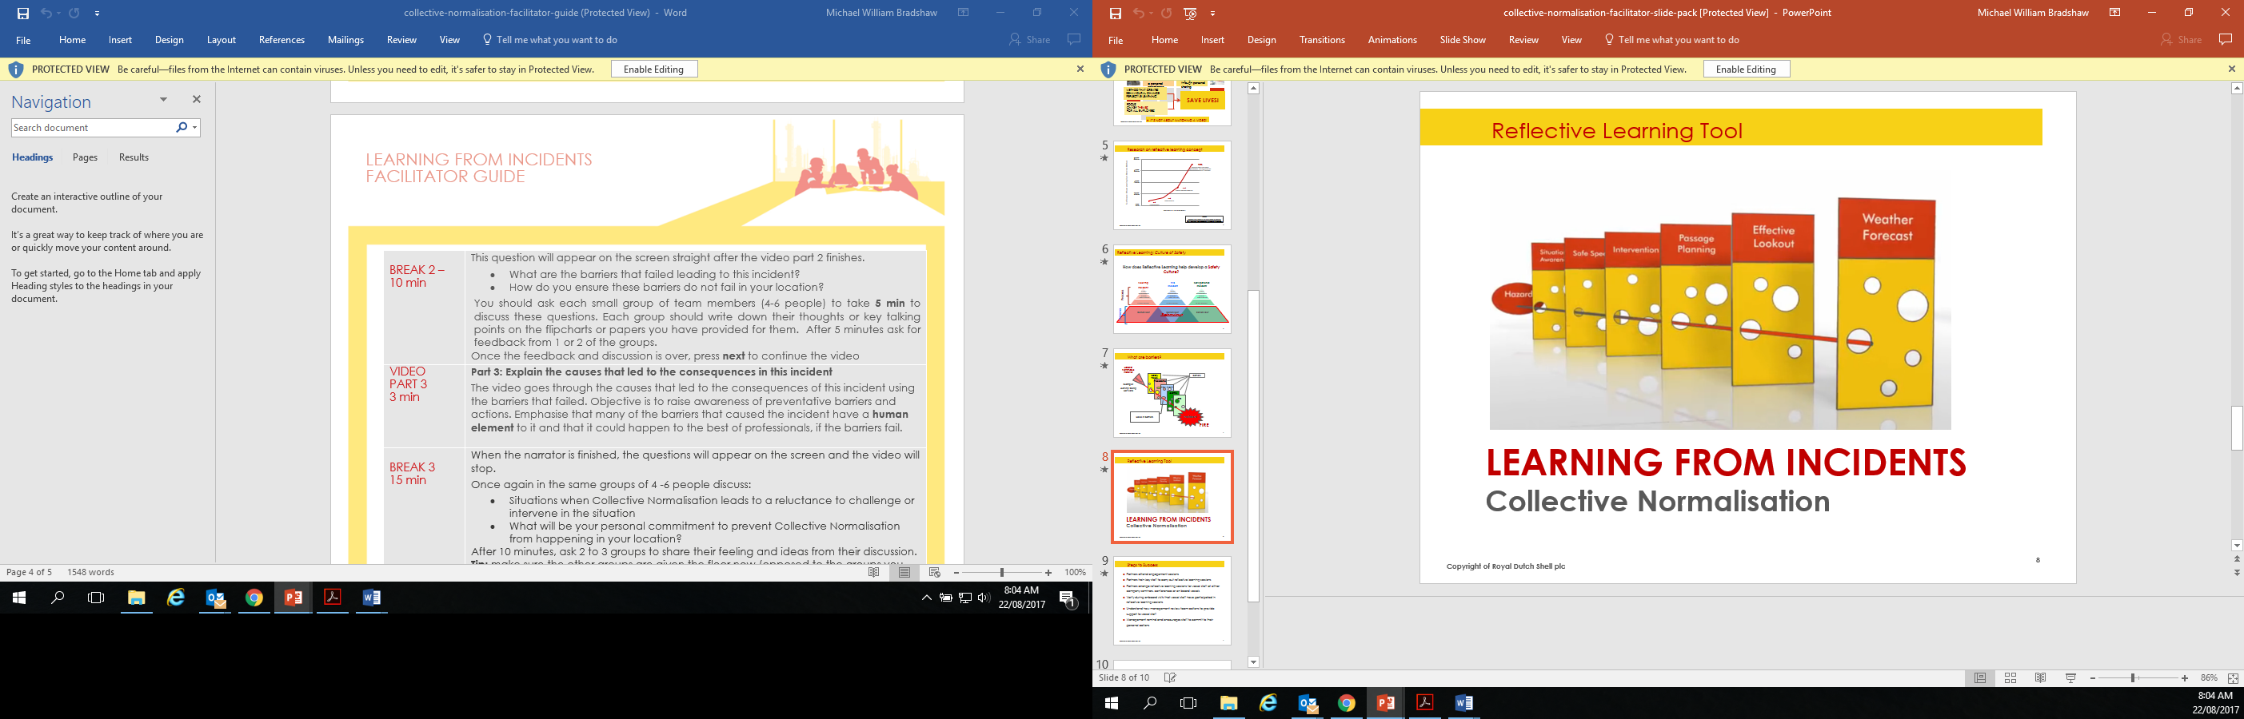
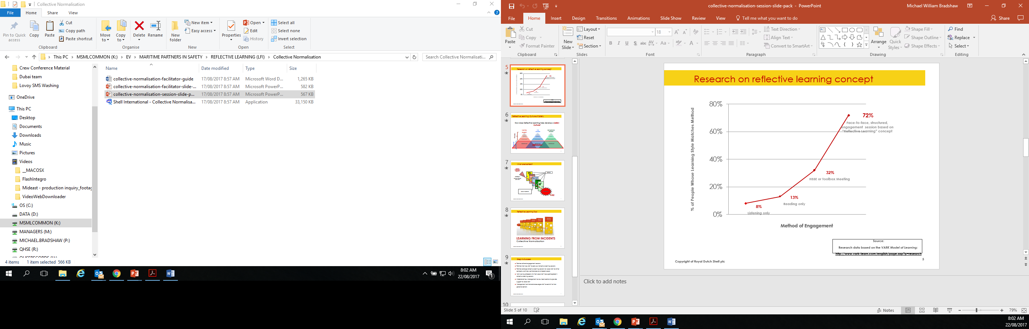
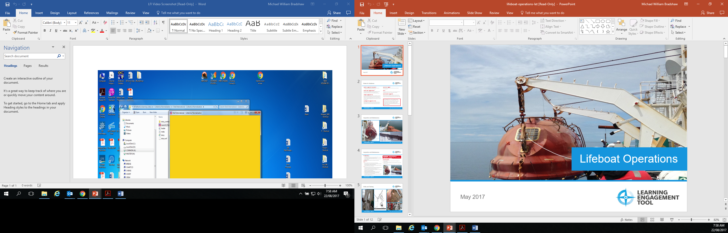
Partners in Maritime Safety
Sharing best practice material through collaboration and engagement, to achieve a step-change in our safety performance.
CEO and Senior Leader Visits – To listen to ship staff concerns over safety and welfare, and discuss “a step change in safety” with all officers and crew.
Reflective Learning - provides an opportunity to reflect on the causes of incidents in order to gain a deeper behavioural understanding.
Learning Engagement Tools - themes to be facilitated on board in small groups.
Resilience - A programme made up of core modules with each module focusing on a different area that makes up our natural capacity to deal with life’s challenges.
Notes:
For Details Refer to HSE Section 1.9

Slide 38
Section Title.
Environmental Excellence

Slide 39
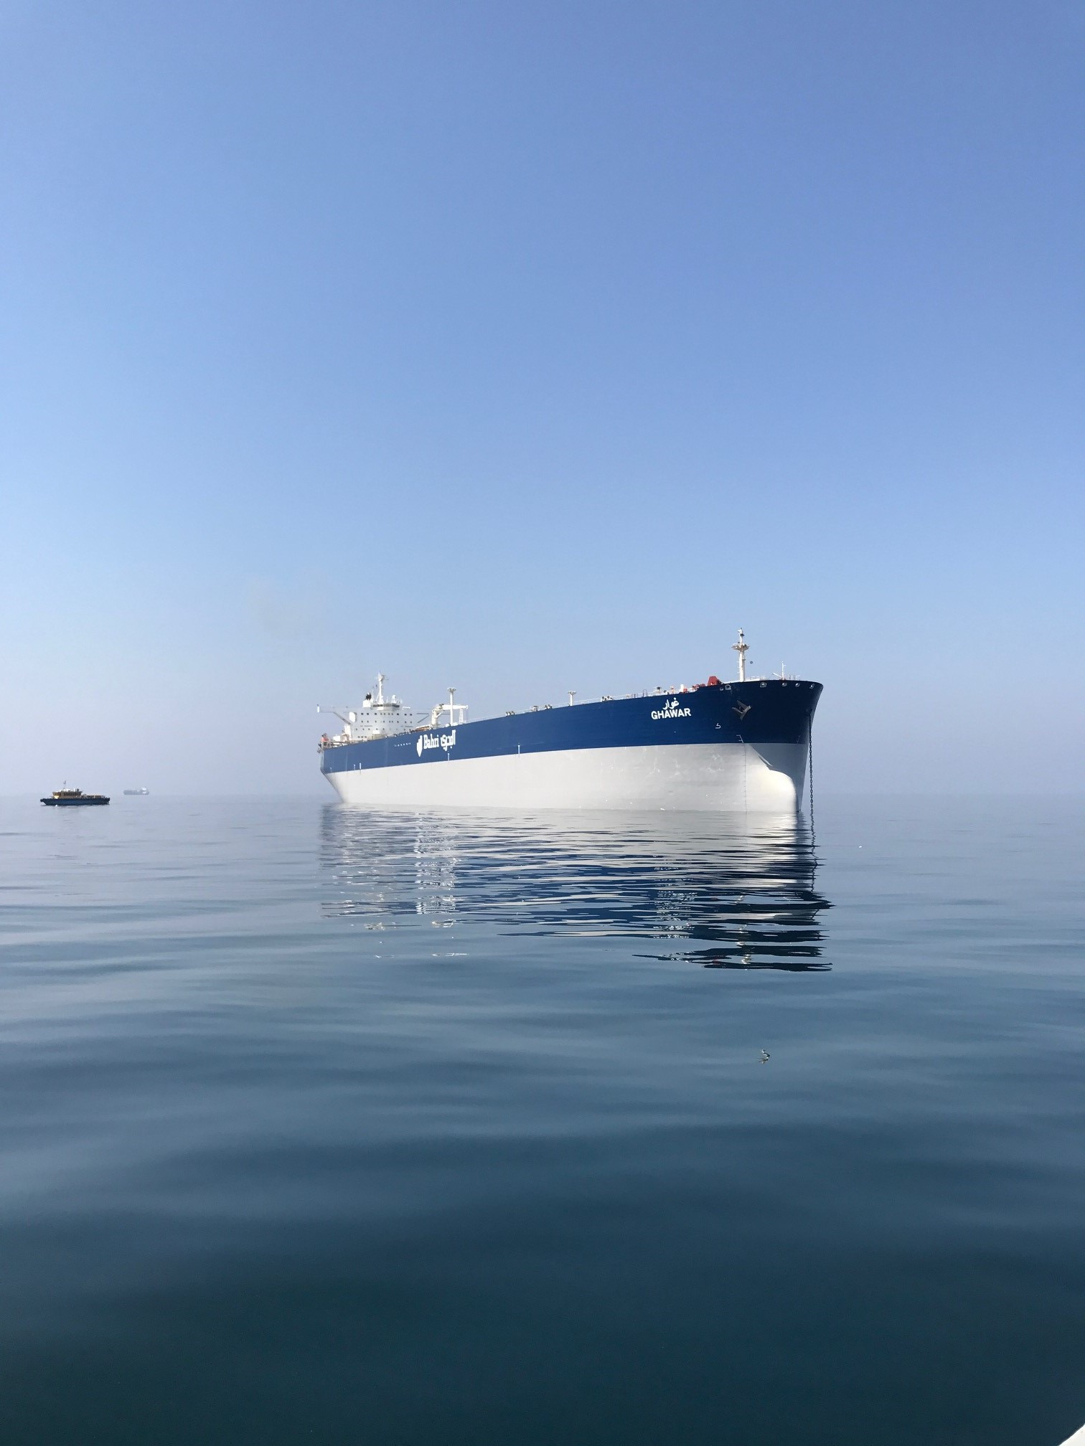
Environmental Excellence
Key Performance Indicators
Company Environmental targets in reduction of waste streams
Application of high performance cargo tank coating reduces tank cleaning time hence reduction in fuel consumption and reduction in carbon emissions.
Application of high performance hull coating will reduce the hull fouling hence reduction in fuel consumption and reduction in carbon emissions.
Annual hull cleaning and inspection of certain class of vessels.
Design initiatives- fitting of Mewis ducts, Electric heaters and propeller boss cap fins resulting in reduction of fuel consumption and carbon footprint.
ECO notations for its 10 new build VLCC’s lined up for delivery from Feb 2017.
Installation of accurate Performance monitoring tools such as Marorka and Kongsberg monitoring systems.

Slide 40
Section Title.
Environmental Compliance

Slide 41
Environmental Compliance
2016 – The most successful year for US DoJ
$363m
In Penalties
32
Years jail time for seafarers
$40m
In single penalty
Promise
To aggressively prosecute

Slide 42

Environmental Compliance
The Stakes are High
February’17 – A federal jury convicted two engineers of the tanker Green Sky of falsifying documents to conceal illegal discharges of oily bilge waste and obstruction charges.
January’17 - The US DOJ reports that in 2016, criminal penalties totalled more than $363 million and individuals were sentenced to more than 32 years of jail time
December’16 – Princess Cruise Lines Ltd has agreed to plead guilty to charges of deliberate pollution of the seas and intentional acts to cover it up. Princess will pay a $40 million penalty – the largest-ever criminal penalty involving deliberate vessel pollution
November’16 - Chief engineer of the tanker Cielo di Milano sentenced to 8 months in prison for concealing the deliberate discharge of oily waste into the sea.
October’16 - Owner of the bulk carrier Gallia Graeca fined $1.3 million for violation of the Act to Prevent Pollution from Ships (APPS) by not recording the discharge of oily waste water into the ocean.

Slide 43
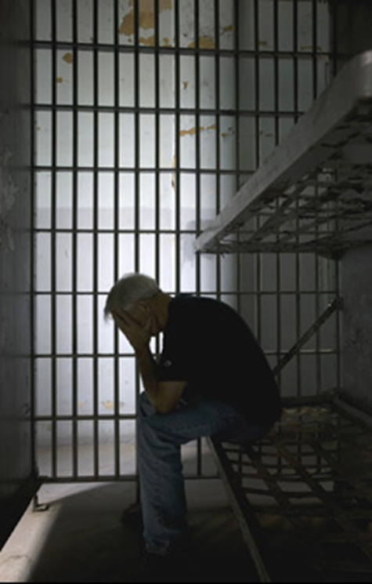
Environmental Compliance
The Stakes are High
Environmental enforcement actions continue to grow rapidly.
The possibility of criminal prosecution of companies or individuals for environmental violations is a significant risk
Jail sentences on the increase
Fines are mounting rapidly and increasing number of companies being fined.
Compliance programmes with government oversight are expensive – more expensive than the actual fines.
Reputational damage is severe
The DOJ has long held a policy of prosecuting the highest ranking individual in a company responsible for the violation of environmental laws.
These prosecutions can be successful without having to prove that the defendant had direct knowledge of the wrongdoing

Slide 44
Environmental Compliance
The Records – Not the Pollution
FALSE LOG ENTRIES OR OBSTRUCTING JUSTICE
In all of these cases, the overboard discharges were concealed by false and fictitious entries in the Oil Record Book,.
Obstruction of Justice - Senior ship engineers denied knowledge of the bypassing and submitted false written statements to the Coast Guard denying overboard discharges and the use of bypass equipment
Intentionally submitting any incorrect record to a government official in the USA is a FEDERAL offense.
Official records include ORB, Sounding Books, Ballast Logs, Garbage Record Books, MARPOL VI Record Books, Deck / Engine Logs and VGP records, etc.

Slide 45
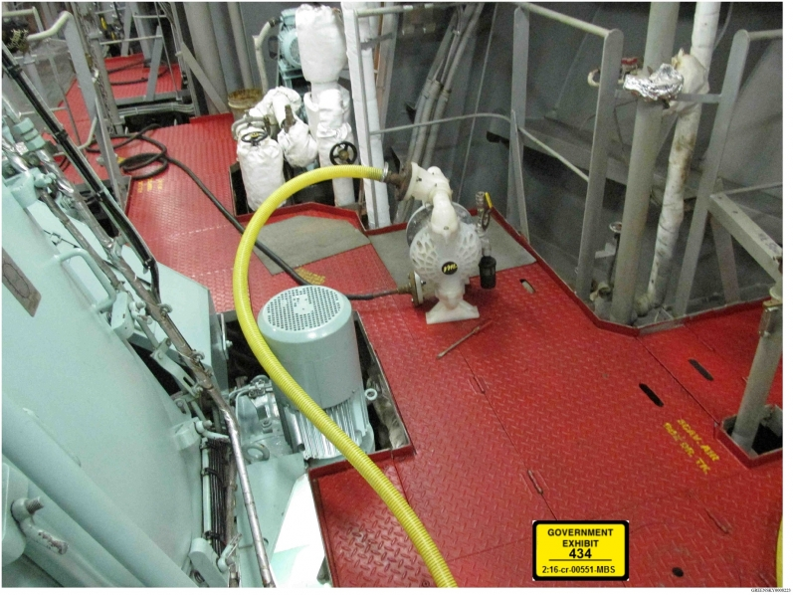
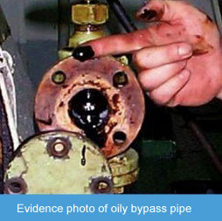
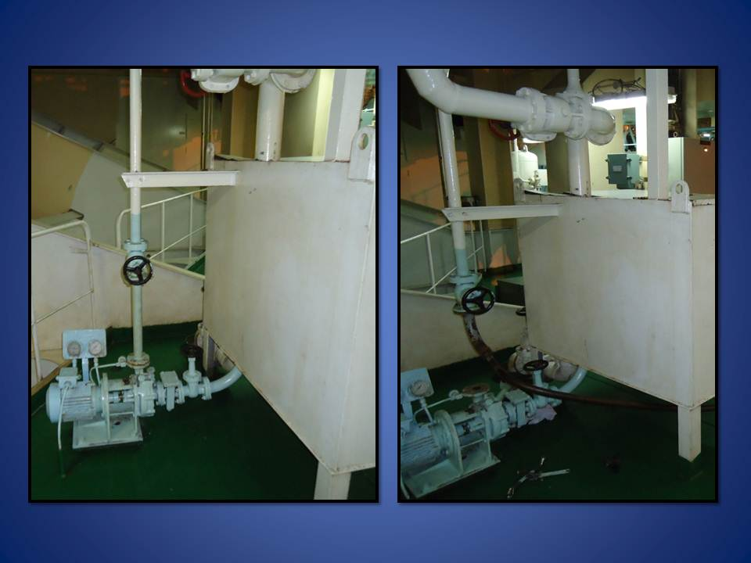
Environmental Compliance
What to watch out for

Slide 46
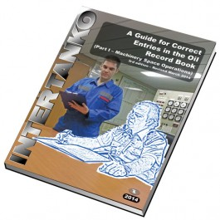
Environmental Compliance
Critical Factors
Commitment – The Senior management are absolutely committed to protecting the marine environment and expect the same from every employee – ashore and afloat
Accuracy – All records kept must be accurate, concise and consistent. This is particularly important between daily sounding logs and the official ORB.
Responsibility – Responsibilities for daily soundings, oversight of entries in to official records, and operating MARPOL-related equipment clearly documented in the CE’s Standing Orders.
Compliance - Strict adherence to maintain the Company’s Environmental Seal Program and recordkeeping for Flexible Hoses
Remove barriers to compliance – ensure vessel has sufficient MARPOL-related spares, such as OWS filters.
Training - Officers and crew trained in key MARPOL controls – Videotel VOD Courses 963-966 apply.
Demonstrate with confidence - Crew able to demonstrate full OWS testing – not just OCM alarm.

Slide 47
While the USA has the most aggressive enforcement of environmental policies, non-compliance shall not be tolerated anywhere in the world.
Failure to follow the rules could result in the Company being penalized financially, those involved going to jail, and the reputation of our Company destroyed.
Any concerns should be raised with your shore fleet team and the Company DPA.
We need your support and your commitment to environmental compliance

Slide 48
Section Title.
Welfare & Development

Slide 49

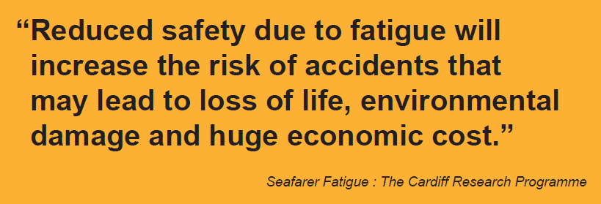
Welfare - Fatigue Management
Notes:
Crewing 2.6 Hours of work and rest
Masters are responsible for ensuring that all officers, crew and riding gang members are rested as per ILO requirement prior to undertaking their duties and record is accurately maintained by each individual.
Accuracy is VERY important and false records to secure extra overtime will NOT be tolerated.
Master has any doubts, about the ability of the ship staff to continue with the operation in hand due to fatigue, he is entitled to stop the operation until such time as he is satisfied that sufficient number of officers/crew are rested to allow safe operation.
Rest / Fatigue – Every Master and Seaman has a personal responsibility to be properly rested when commencing duty, particularly before watch at sea and in port, and to obtain adequate rest during
allocated rest periods.
Mideast vessels have been provided with ISF Watchkeeper system which allows each crew member to record his work and rest hours. The computer program is based on the ‘Minimum hours of rest’
and will show up breach of rest hours at any given time during the working period in the past 24 hours. Each crew member, including the Master & Riding gang members, shall maintain their rest
hour record using this software.
Mideast considers more than 2 instances of rest hour breach per individual in a month during the course of normal vessel operation as ‘significant non-compliance’.
CRW/2.7 NORMAL WORKING HOURS
Normal working hours applicable to vessels under Mideast’s management is based on an eight hour day with one day of rest per week and rest on public holidays.
The normal day working hours to be in force on the majority of the Mideast vessel’s are as follows:
Monday to Friday - 0800 to 1200, 1300 to 1800hrs. (1hr overtime)
Saturday - 0800 to 1200, 1300 to 1700hrs (4hrs overtime)
Sunday - 0800 to 1200hrs (4hrs overtime)
Tea / Coffee break 1000 to 1015, 1500 to 1515.
All personnel are to have their evening meal each day at 1800hrs. Watch-keepers are required to work overtime as and when the Head of Department requires, but always taking into consideration Mideast’s limitation of hours, see section 2.8 & MLC 2006 requirements.
CRW/ 2.8 OVERTIME & LIMITATION OF HOURS
Any overtime hours worked must take into account compliance with Rest Hours requirements.

Slide 50
Welfare & Development
Safety Committee Meetings
To enhance the development of “safety culture” onboard the vessel and to promote the highest standards of safety and safe operating practices Mideast managed vessels shall develop a safety committee in line with guidelines contained in HSE manual. This will further develop open lines of communication by giving a forum where all personnel have easy access to a safety representative who will discuss their views on any safety related topic.
Safety committee will be chaired by Master with Chief officer as safety officer, Chief engineer a permanent member with four elected representatives by holding fair elections. One representative from within the officers and one each from deck, engine and catering department respectively.
Notes:
HSE / Section 1.13
Frequency of Meetings
The Safety Committee shall hold formal meetings:
◻ At intervals not exceeding one month,
◻ As soon as possible after any serious incident or accident on-board, and
◻ If advised by the company.
The meeting shall follow the agenda provided in Mideast/FMS, Form no. 101, which covers nine (9) agenda items with adequate notes for guidance, and Section on ‘key dates to remember’

Slide 51



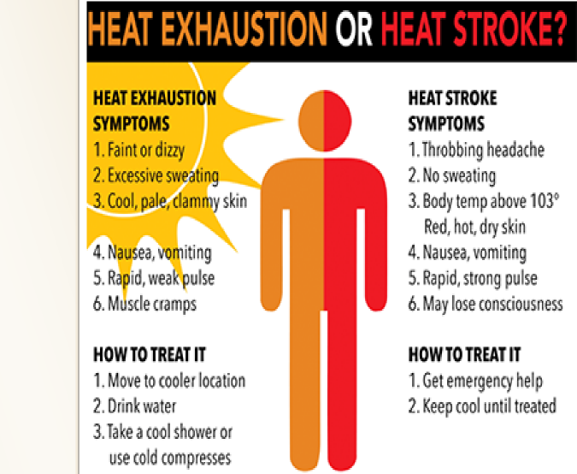

HEALTH & HYGIENE
Heat Stress is any combination of air temperature, thermal radiation, humidity, airflow, and workload that may stress the body as it attempts to regulate body temperature.
Many ships contain environments with high temperature and humidity levels which can lead to heat stress conditions that may have significant impacts on safety and productivity aboard ships .
Heat stress can lead to a number of illnesses, disabilities, and even death. Exposure to continued high temperatures leading to heat stress conditions can reduce work performance and morale and impair mental awareness, increasing the risk of workplace accidents, and ultimately compromising the readiness of the ship . Moreover, heat stress may directly impact manpower requirements aboard ships when heat exposures are high enough to require work/rest rotations.
SAFETY TIPS
⇒ Hydrate. Drink 8 to 16 cups of water a day.
⇒ Keep a lookout for shipmates and watch for symptoms.
⇒ A “break-in” period of about two weeks, with progressive degrees of heat exposure and physical exertion, will mini- mize the number of heat injuries and improve productiv-ity in the long term.
⇒ Eat a well-balanced diet. Salt food to taste.
⇒ Limit how much coffee and sodas you drink.
⇒ Don’t wear coveralls over utilities during damage-control or casualty-control drills in hot and/or unventilated spaces.
⇒ Get plenty of rest, at least 6 hours every 24 hour period.
⇒ Report heat-stress problems (missing lagging, steam leaks, poor ventilation, etc.).
⇒ Ensure that the recovery time is in a cool area when leaving the heat stress working space.
⇒ Schedule drills early or late in the day.
⇒ Avoid starch in uniforms
Around 101°F/38.33°C:
The body is dissipating heat as fast as it can by perspira-tion, but the blood vessels nearest the skin begin to dilate as well. Thus, skin reddens and is hot to the touch. The pulse quickens. Blood pressure begins to drop. This is very uncom-fortable. This is the begin-ning of heat exhaustion.
At 102°F/38.88°C:
Dizziness, nausea, breath-lessness, fainting, and headaches. The skin feels dry. The normal mecha-nisms for carrying away core heat are no longer sufficient.
> 103°F/39.44°C:
Weakness, vomiting, head-ache. This is a medical emergency!
>104°F/40°C:
Heat stroke. Confusion, dehydration and seizures are possible.
>105°F/40.55°C:
Delirium. If not treated immediately,internal organs will begin to fail.
>106 °F/41.11°C: Convulsions
>107 °F/41.66°C: Coma
>108 °F/42.22°C: Death
Kindly refer HSE 5.13.2 “Exposure to Heat” for comprehensive guidance.

Slide 52
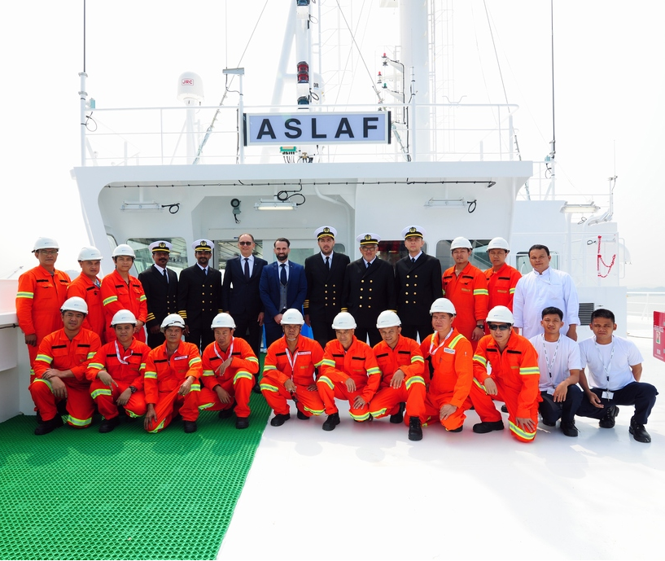
Welfare & Development
Appearance
Notes:
OFFICERS AND RATINGS APPEARANCE WHILE VESSELS ARE IN PORT
It is important that officers and crew are smartly presented at all times and in particular when the ship is being inspected/visited by shore personnel. No working gear is to be worn in the officer’s saloon or crew’s mess room. Deck Officers, when carrying out bridge duties are to wear uniform. However during the night watches this requirement may be relaxed subject to Master’s permission.
During pilotage, deck officers must wear their uniform at all times when on the bridge.

Slide 53

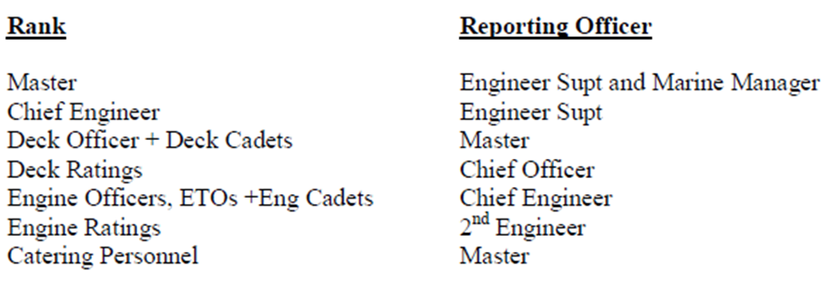
Welfare & Development
Personal Performance Evaluation
It is the Master’s duty to ensure that a Performance Appraisal Report is completed and submitted upon the signing off of each seafarer from the vessel and/or when the Master or Head of Department leaves the vessel.
However, it is essential that the Master or the Head of Department must have spent at least 2 weeks on board with the person being appraised so as to be in a position to evaluate performance.
Notes:
Aim
“…..to record an assessment of an employee's performance, potential and development needs”.
The appraisal is an opportunity to take an overall view of work content, loads and volume, to look back on what has been achieved during the reporting period and agree objectives for the next”.
Performance Appraisal Reports
All seafarers shall be evaluated on their performance during each period of their employment
All reports to be sighted and signed (electronically) by the Seafarer and Master
Reports to be filed prior to Master or C/Engr signing off or whenever crew member disembarks
Circulated internally within the office for comments
IMPORTANT POINTS:-
Make sure your Senior takes you through an appraisal - You can approach him prior to sign off and ask
Make sure you sign it or not worth paper its written on - Signing doesn’t mean you agree but does mean you have sighted it
If you don’t agree discuss with Senior Officer
Use the comments section to reflect your views on appraisal
Rehire Status - Box remain blank
- Make sure yes or no is ticked
If you refuse to sign, Master will write on document

Slide 54
Section Title.
Company Incentives

Slide 55
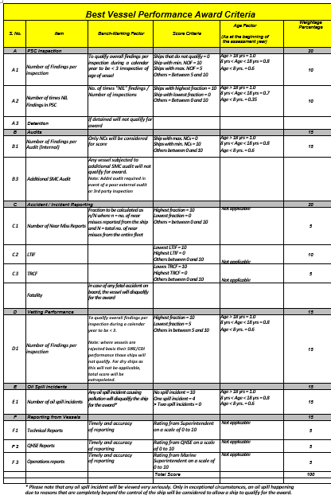
Company Incentives
Best Vessel Award - Make it Your Vessel
Shipboard team plays an important role in promoting a strong and proactive safety culture on board by clear directions, by their behaviour and by demonstrating commitment to safety and environmental excellence.
Winning Vessel – USD 2500 Welfare Fund PLUS payments to all crew who have served more than 30 days at any point that year. A plaque shall be delivered to the winning vessel.
First Runner-Up – USD 2000 Welfare Fund
Second Runner-Up – USD 1500 Welfare Fund
We are also look for ideas on how we can include vessel fuel efficiency initiatives in the scheme.
Notes:
Refer to HSE Section 1.12 & Appendix 7

Slide 56

Company Incentives
Safety Suggestions (Best Safety Idea)
The company encourages all crew members to submit safety related ideas to the office. To promote this concept Mideast offers a cash reward of 500 USD as recognition to individuals whose contribution makes an exceptional difference to health and safety on board.
At the end of each quarter the shore office management group shall select the ‘BEST SAFETY IDEA OF THE QUARTER’.
1
Notes:
HSE / Section 1.11
All safety suggestions received by the Master shall be presented for discussion at each SCM (Agenda Item 9). The Safety Committee shall identify the ones where the originator:
Can demonstrate his idea has resulted in significant improvement over previous conditions, or Is seen making an extra effort to improve or correct a specific aspect of safety within the workplace.
Also attached is a poster which is being printed on A3 size plasticized paper and will be sent out to the ships.

Slide 57

Company Incentives
Best Near Miss
To promote its vision of “Safety Driven ship managers” and to enhance safety culture onboard, we have a reward scheme for best near miss reporting. It is a two tiered scheme as follows:
The Safety Committee on board shall judge the best near miss reported during the month and the person reporting it shall be presented a token award as advised by Mideast from time to time.
At the end of every month, the best near miss reported from the fleet shall be evaluated by the Mideast management team. The crew member reporting it shall receive a reward the nature and value of which shall be declared by Mideast.
1
Notes:
Refer to HSE Section 17.6.1

Slide 58
Thank you

